Slide 1
Leading Ladies Tea
Theme: Sisters Inspiring Sisters
...teach the older women to be reverent in the way they live…but to teach what is good…then they can urge the younger women… Titus 2:3-4
Saturday ~ October 22, 2016 ~ 10:00 AM

Slide 2
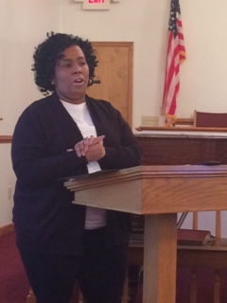
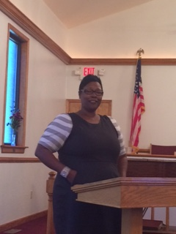
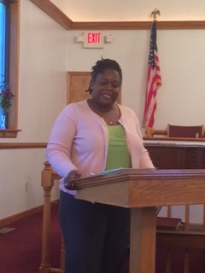
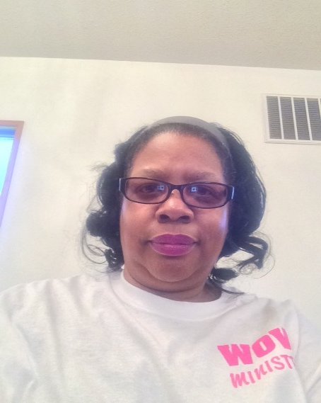
Program Speakers
Sister Schneria Valentine
Topic
Proverbs:3:5-6 Trust In The Lord
Sister Shannon Griffin
Topic
Philippians 4:13 I Can Do All Things
Sister Shelly Gatling
Topic
Haggi: Consider Your Ways
Sister Wendy Turner
Topic
Titus 2:3-5 Teach The Young
Sister Michele Lipscomb
Topic
Proverbs: 22:6 Train Up A Child

Slide 3
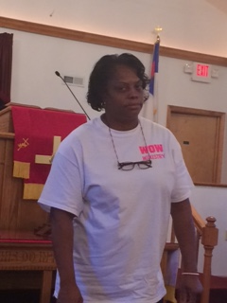
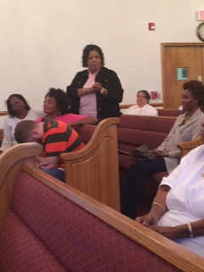
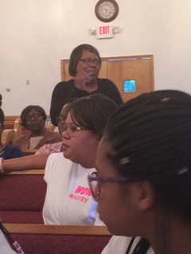
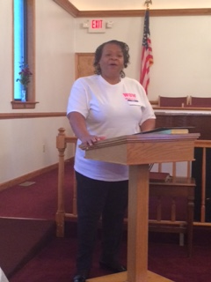
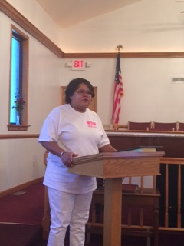
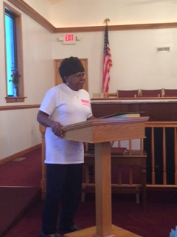
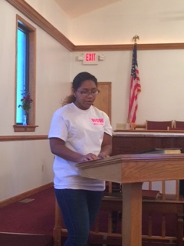
Program Participants
Rev. Dorothy Richardson
Commenting on Program
Evangelist Jackie Morgan
Commenting on Program
Minister Essie Sykes
Commenting on Program
Deaconess Corine Phillips
Prayer
Sister Monica Seward
Songs of Praise
Deaconess Margaret Seward
Worship Leader
Sister Nhya Seward
Poetry Reading
Deaconess Maude Bell
Scripture

Slide 4
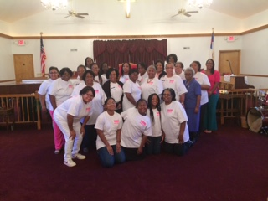
Group Photos

Slide 5
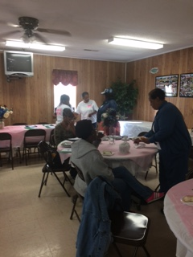
Having Tea

Slide 6
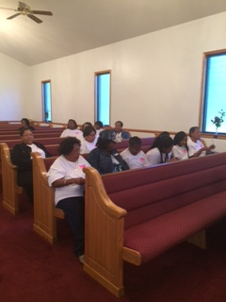
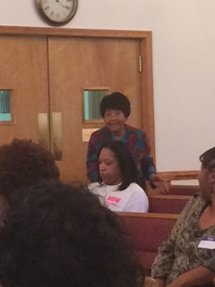
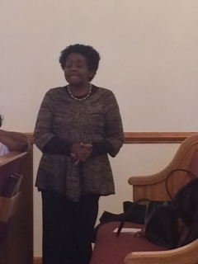
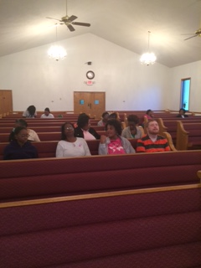
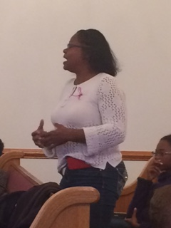
Other Moments

Slide 7
Acknowledgements
We thank all of the speakers and all of the ladies from other Churches that joined us for a wonderful program. We send a special thank you to the ladies of Brown Grove Baptist Church for their overwhelming support of our program. Your kindness and thoughtfulness will always be remembered. May God continue to shower each of you with many blessings.

