Slide 1



Mortgage Payoff Celebration
July 3, 2015, will always be an important and memorable date in the history of Pleasant Hill Baptist Church. On this date, Pastor Ralph T. Friend, Pastor Emeritus William E. Clarke, the Deacons, Trustees, and Financial Secretary, met at First Citizens Bank, Lawrenceville, VA, to make the final mortgage payment on the new sanctuary (construction completed in April, 2006). We were all very excited and proud of our accomplishment, but we were very mindful to give God all the Glory. Only with God being our guide and strength were we truly able to succeed. It is important to note that Pastor Emeritus William E. Clarke successfully initiated the vision of the new sanctuary and saw it through the completion of the construction process while he was pastor. Becoming pastor in October 2009, Pastor Friend carried the banner to the finish line, paying off the mortgage 6 years ahead of schedule. These photos are in memory and representative of that momentous occasion.

Slide 2
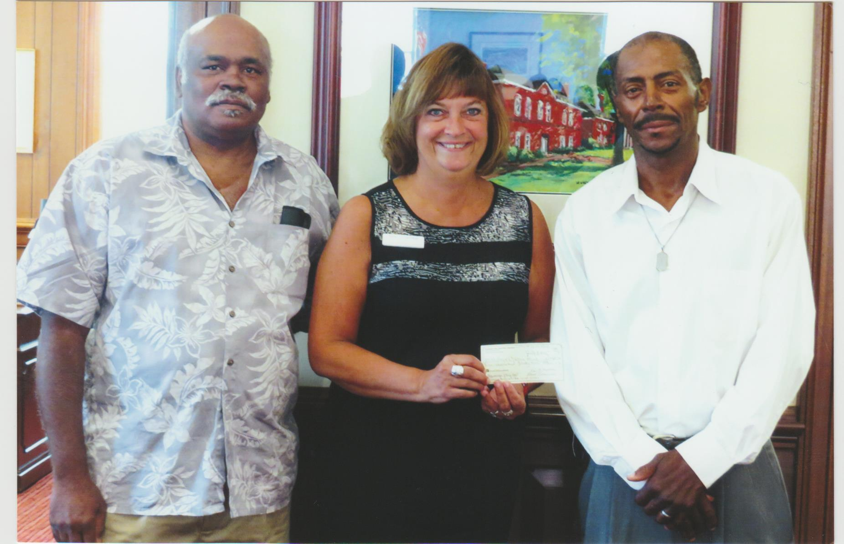
Melvin Lipscomb, Deacons Chairperson - Nancy Edwards, Bank Rep, (holding payoff check) - Lawrence Phillips, Trustees Chairperson

Slide 3
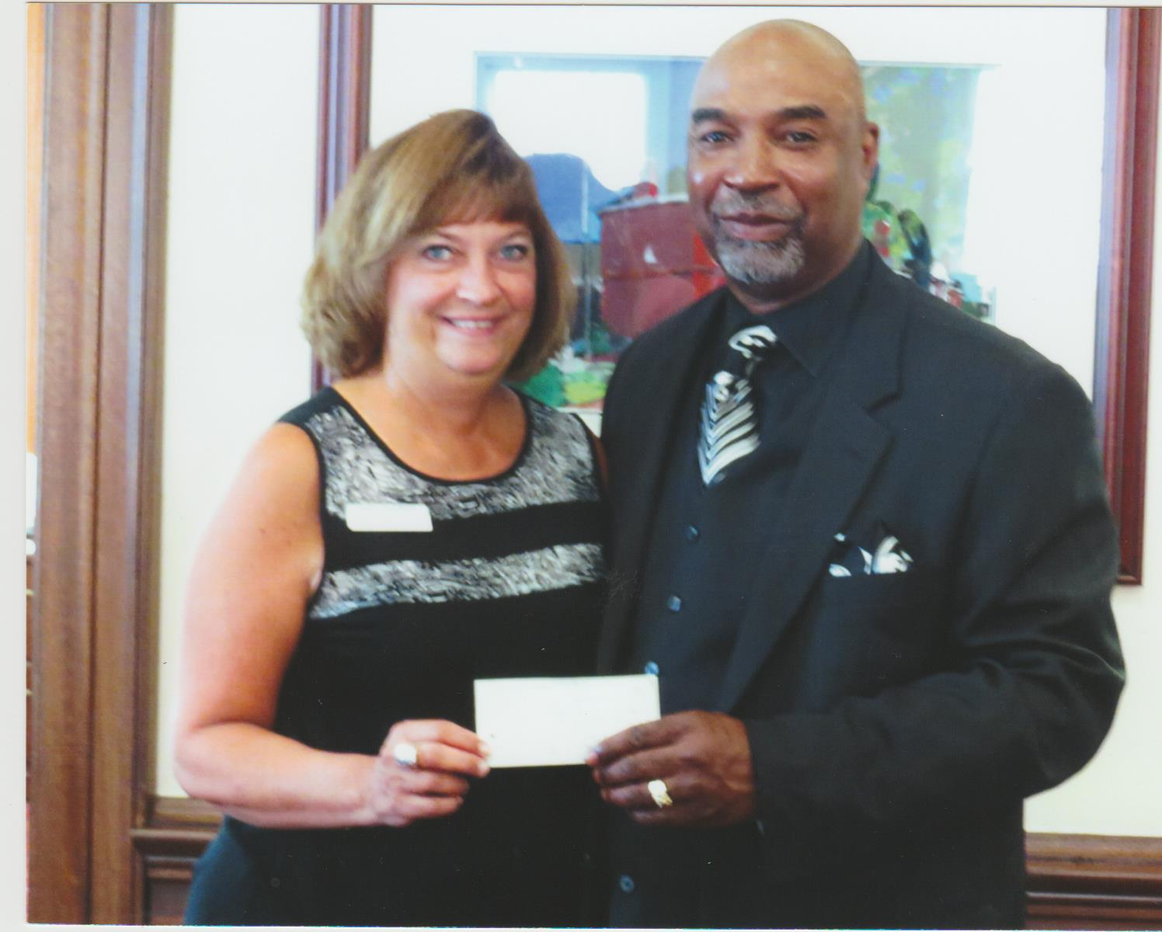
Pastor and Nancy Edwards, Bank Rep (holding payoff check)

Slide 4
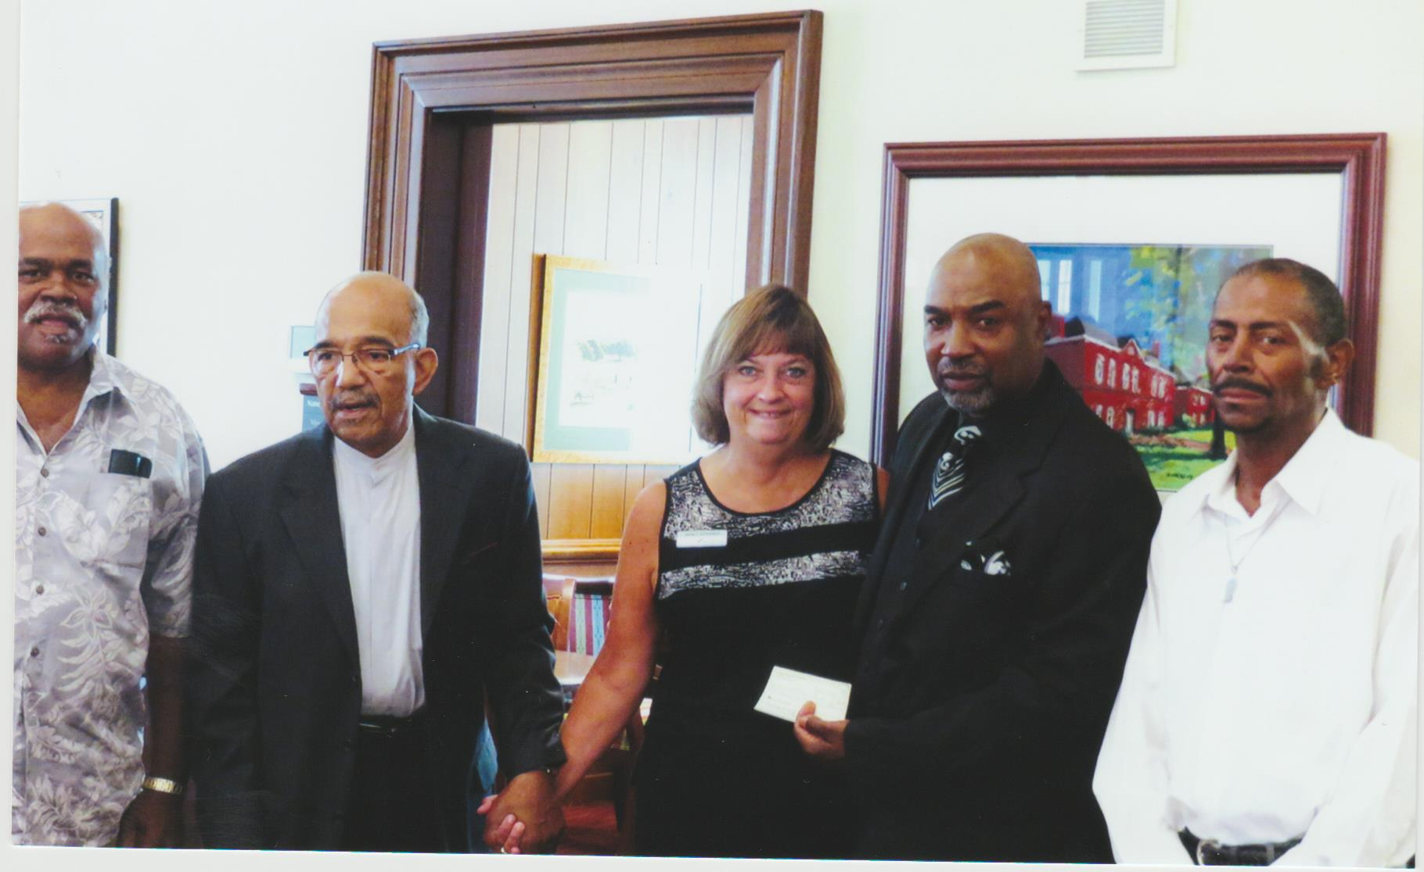
Left to right:
Deacon Melvin Lipscomb, Pastor Emeritus William E. Clarke, Nancy Edwards (Bank Rep), Pastor Ralph Friend, Trustee Lawrence Phillips

Slide 5
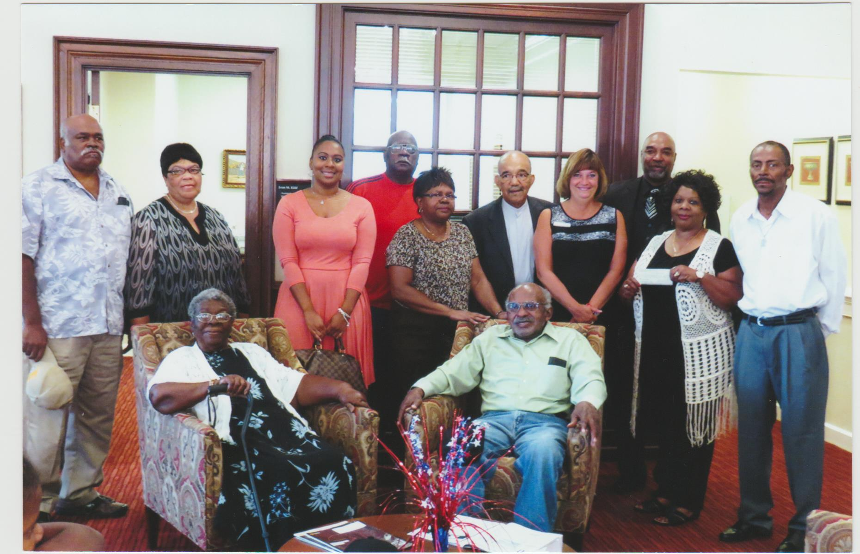
left to right
Seated: Deacon Julia Seward, Trustee Robert Seward
Standing: Deacon Melvin Lipscomb, Deacon Jerline Lipscomb, Trustee Karin Lipscomb, Trustee Frank Lipscomb, Financial Secretary Margaret Seward, Pastor Emeritus William Clarke, Nancy Edwards (Bank Rep), Pastor Friend, Trustee Lois Malone, Trustee Lawrence Phillips

Slide 6
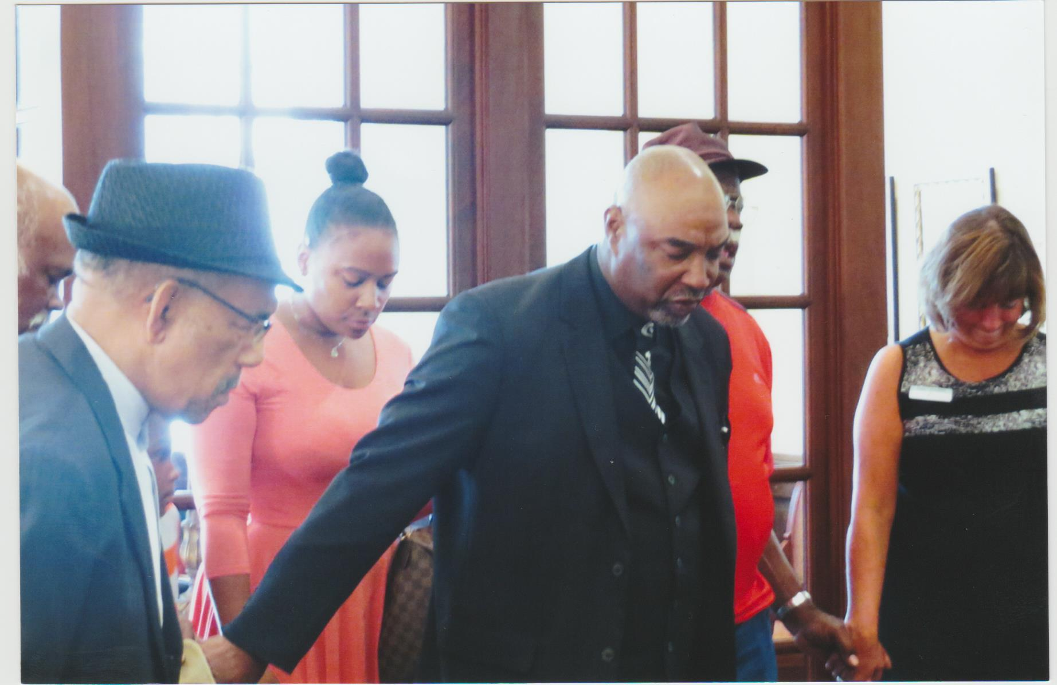
Giving God thanks for our great accomplishment.

Slide 7
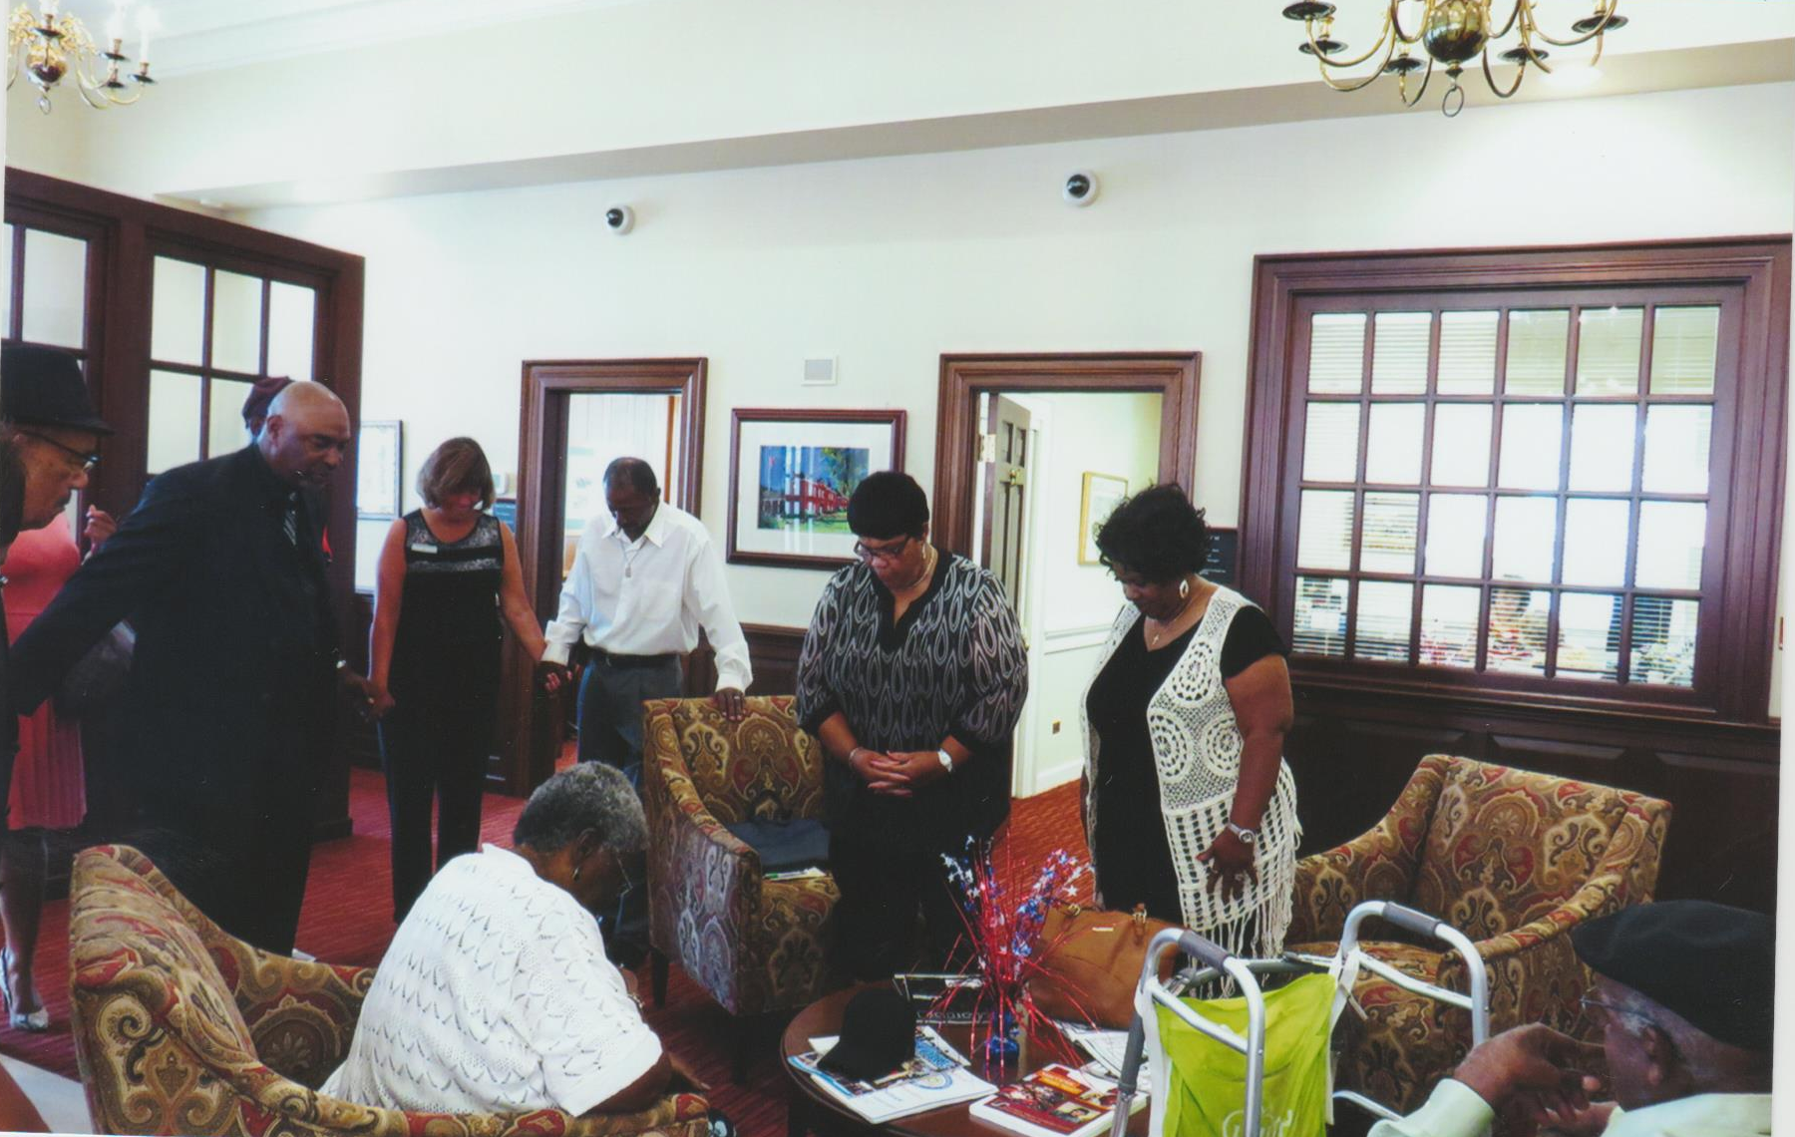
Praying together

Slide 8
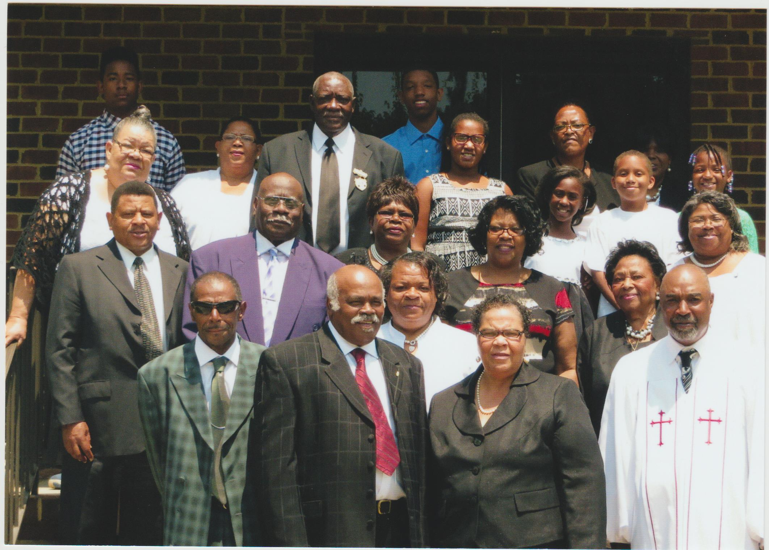
Pastor Friend and Church members photo for newspaper article

