Slide 1
Trustee Robert Lee Walter Seward
A Glance Back Over The Years

Slide 2
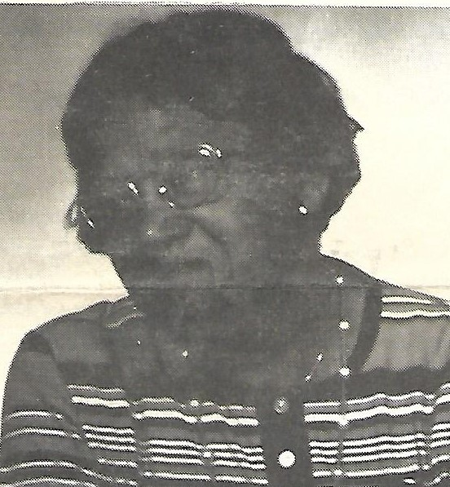
My Parents
The Late John Henry Seward
The Late Bettie Starkes Seward

Slide 3
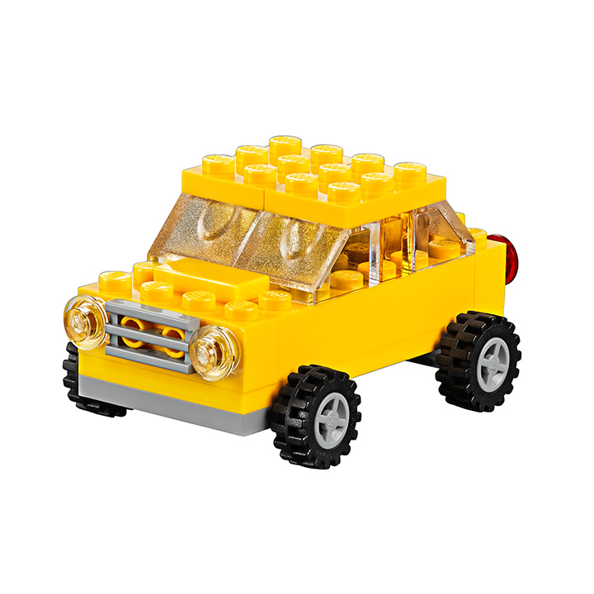
When I Was Just A Little Boy

Slide 4
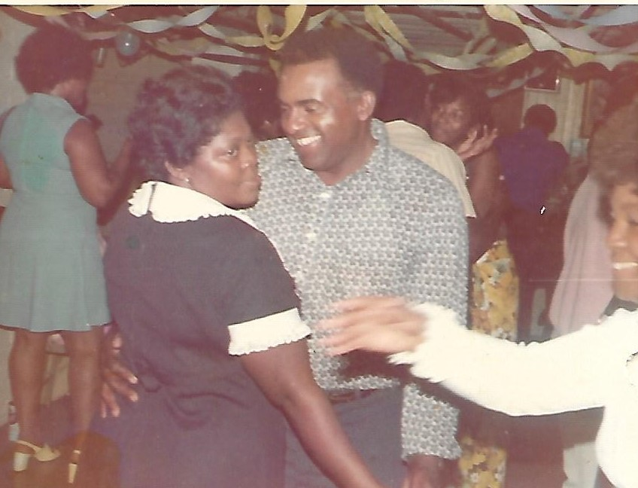
It’s Party Time
At Mamie and Bill’s Home in DC

Slide 5
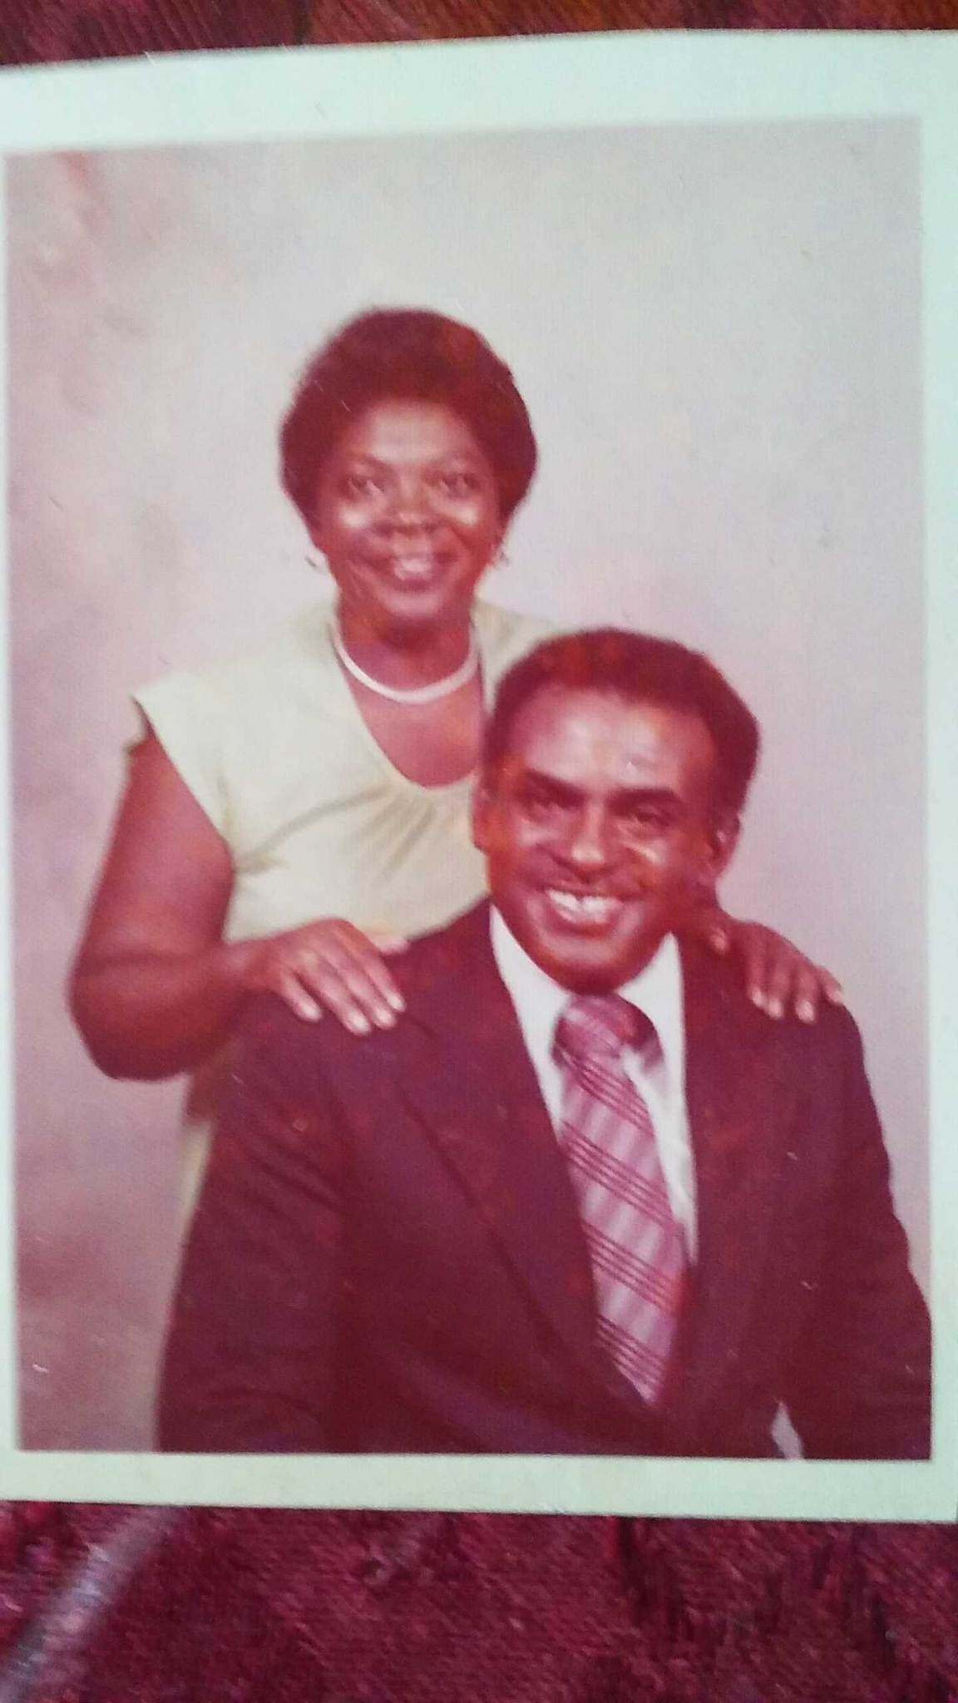
Back In The Day

Slide 6
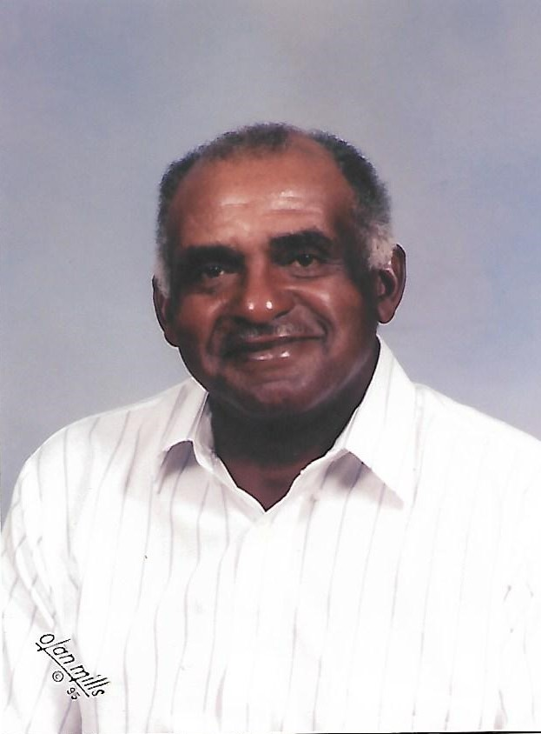
All Smiles 1995

Slide 7
Robert Lee & Julia Seward w/Family harvesting their tobacco crops
The Seward’s invested in a modern tying machine that stitches the tobacco leaves together along the sticks and reduces a day’s work into a few hours. The whole family joins in work
Modern machinery replaced the mules on the farm. The Seward family unloads their machine after pulling four rows at a time.
These pictures are located in the Brunswick County Bicentennial Book Published in 1995.

Slide 8
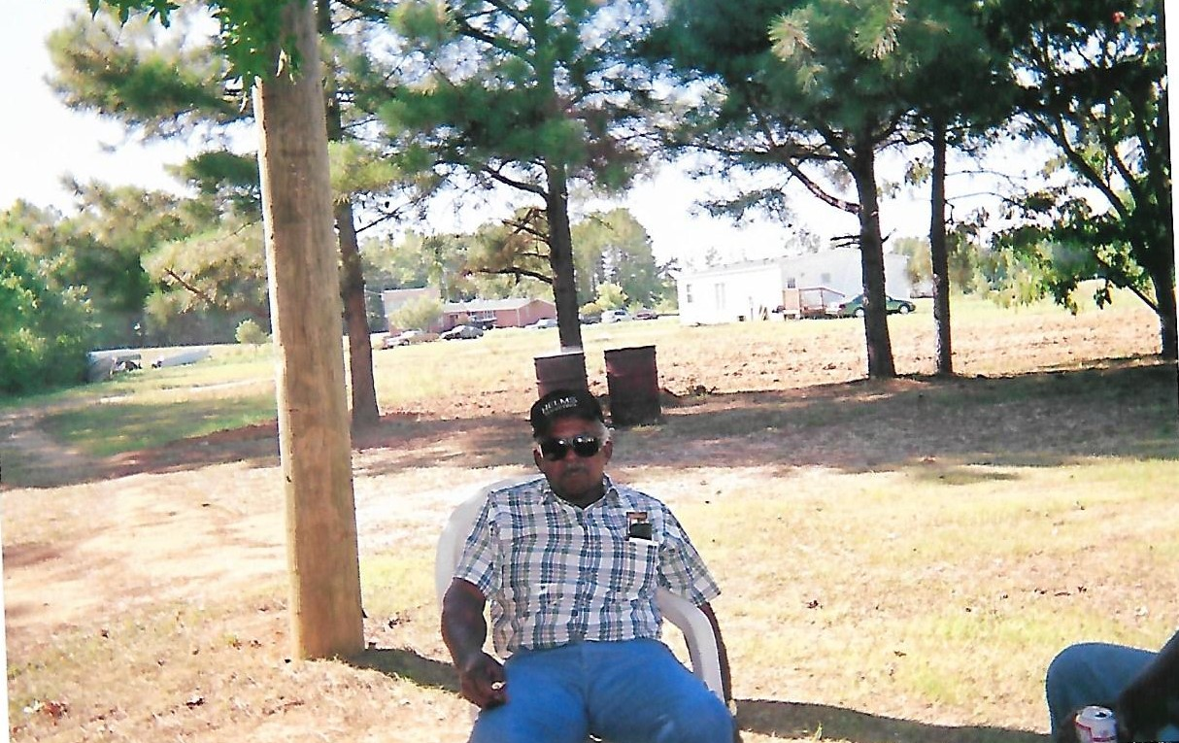
Just A Little Quiet Time

Slide 9
Attending Wedding Frankie and Debbie
November 1998

Slide 10
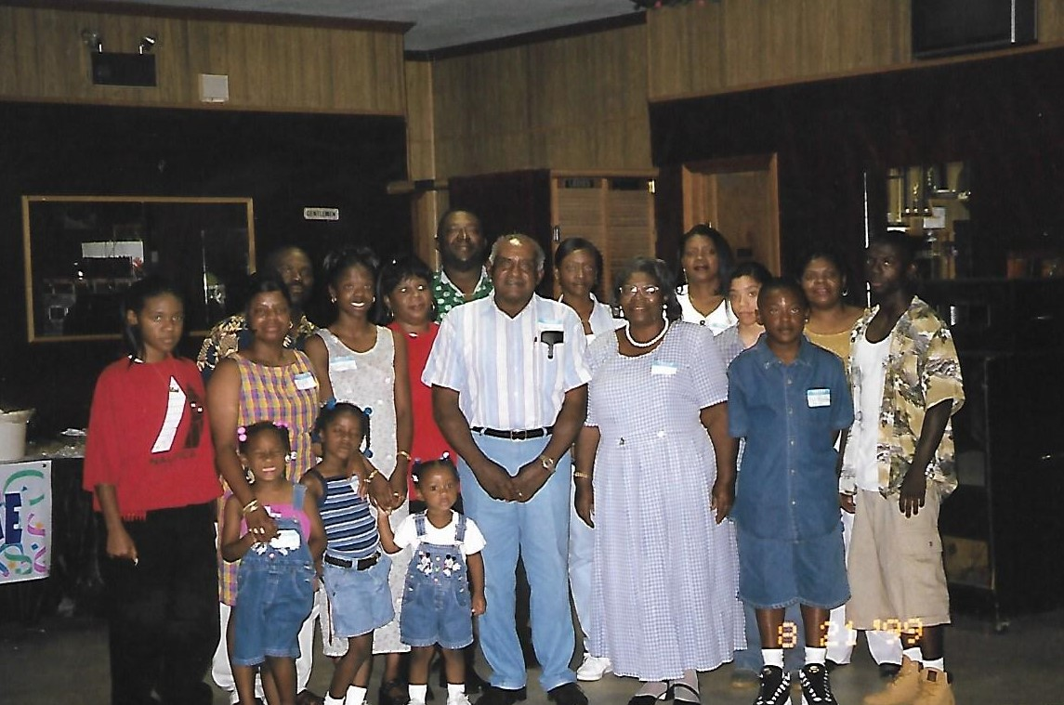
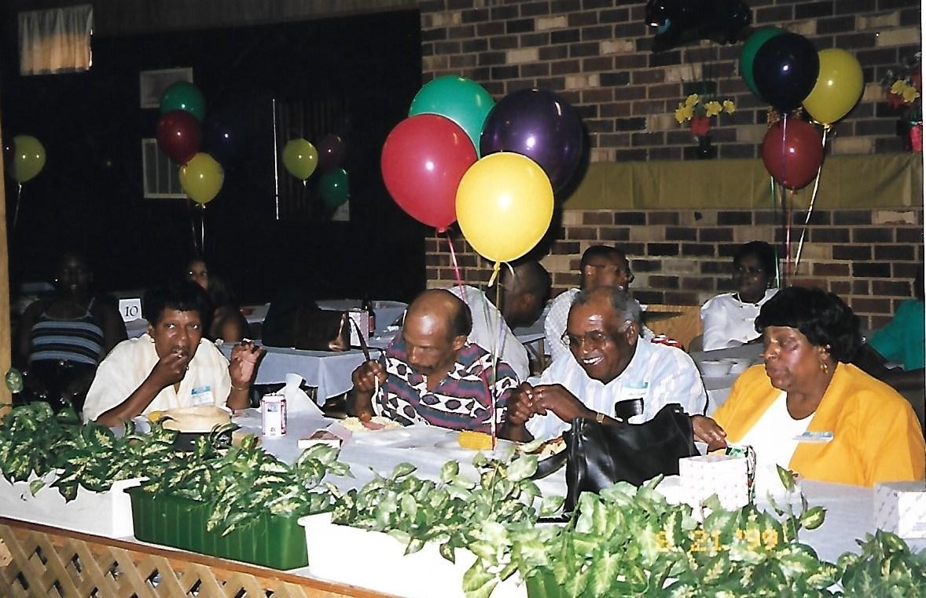
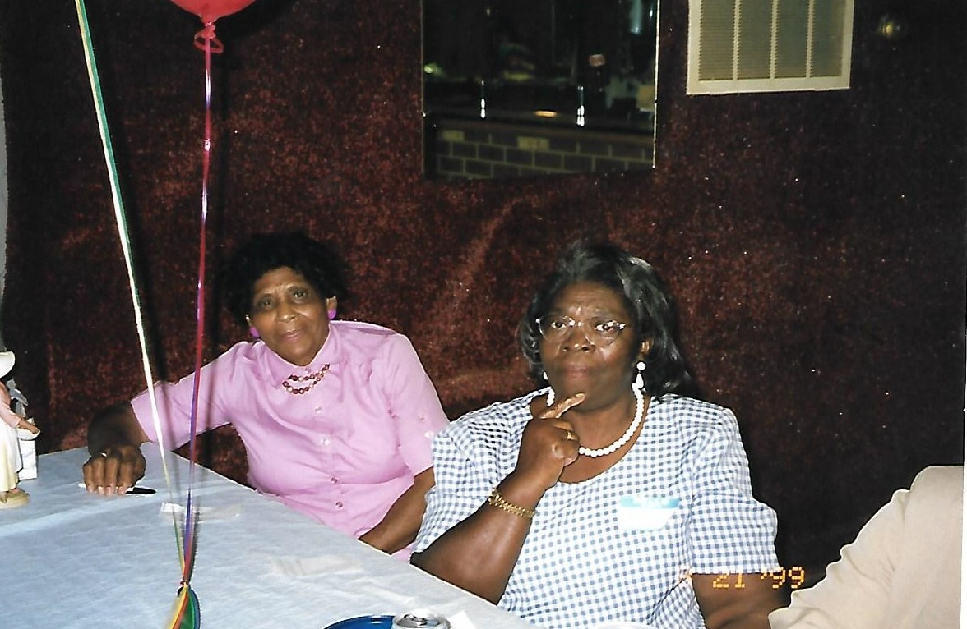
Seward-Green Family Reunion August 21, 1999

Slide 11
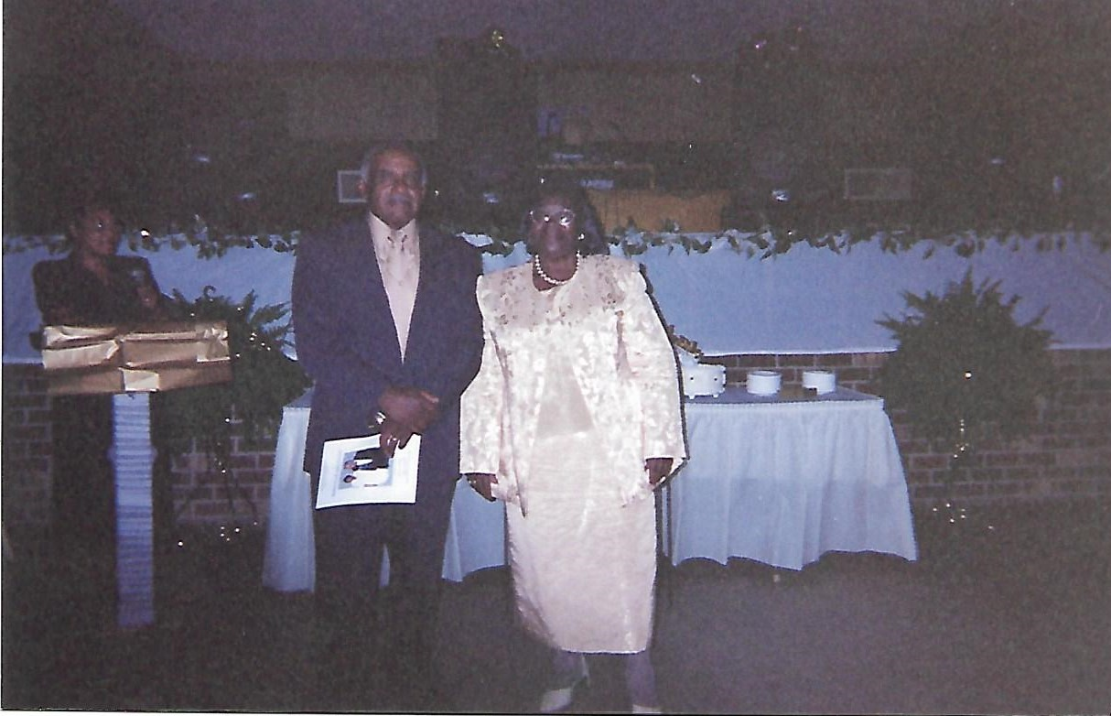
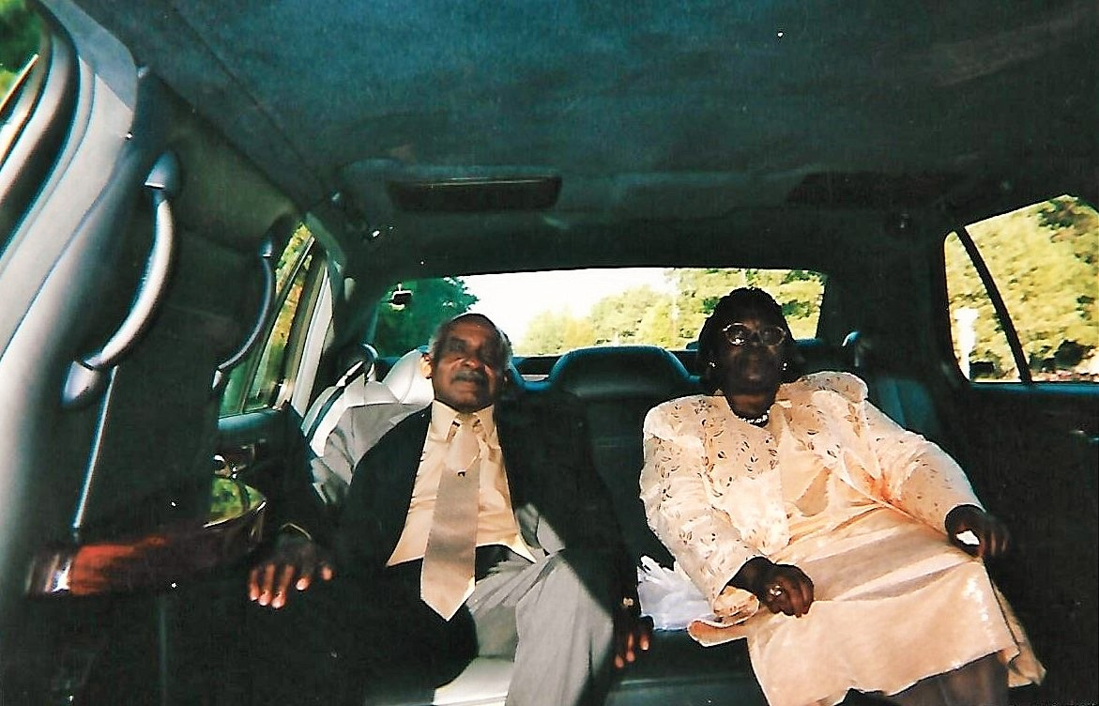
50th Anniversary Celebration October 4, 2002
Cutting the Cake
Graceful Pose
Limo Ride

Slide 12
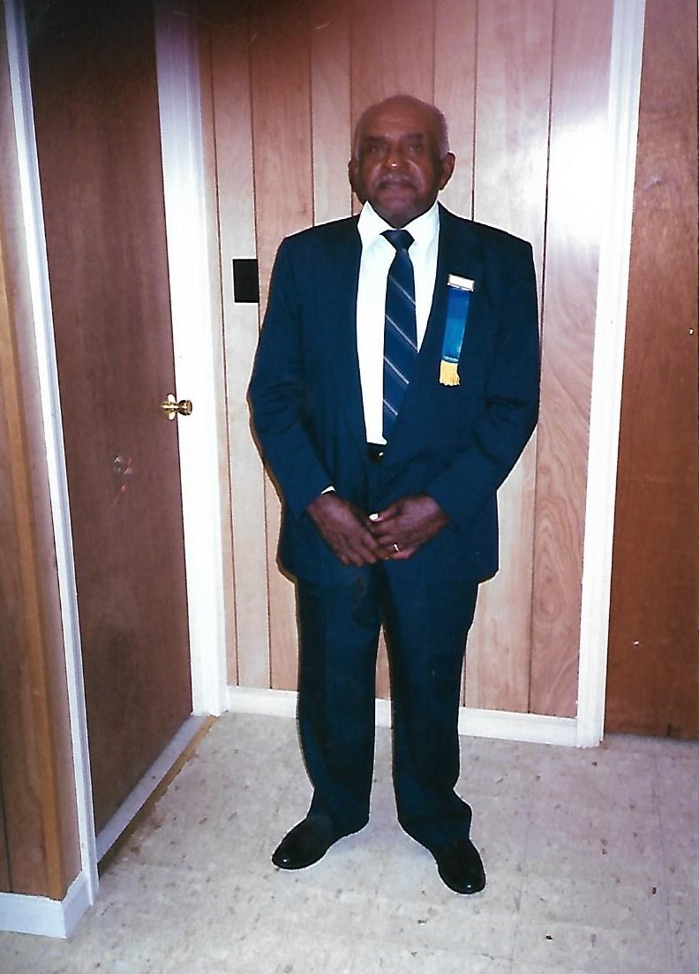
PHBC Trustees

Slide 13
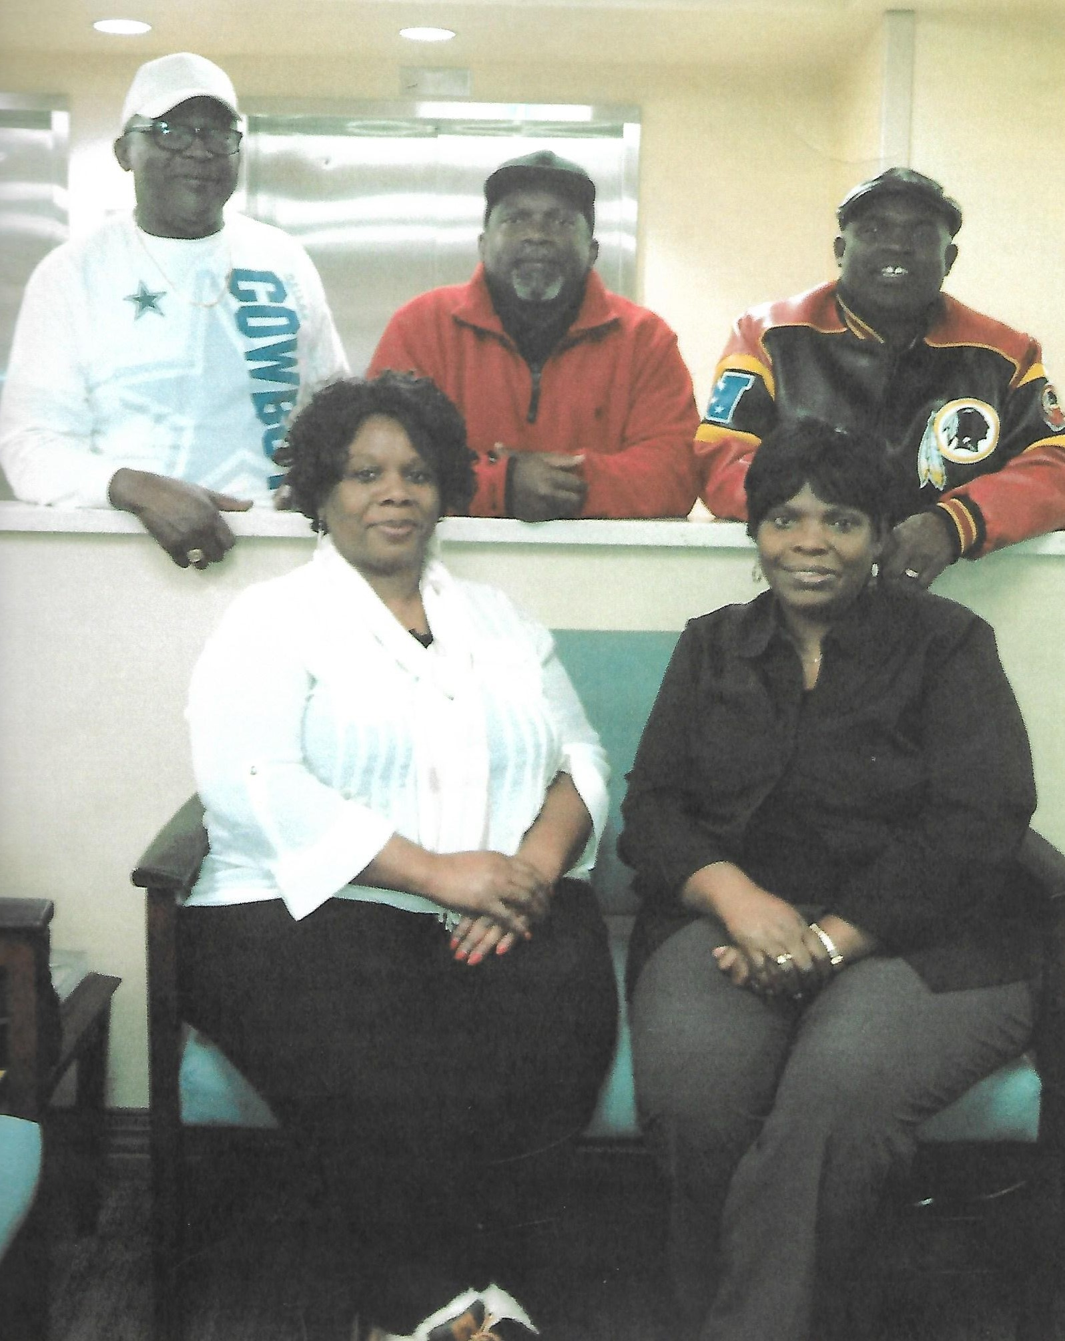
Our Children

Slide 14
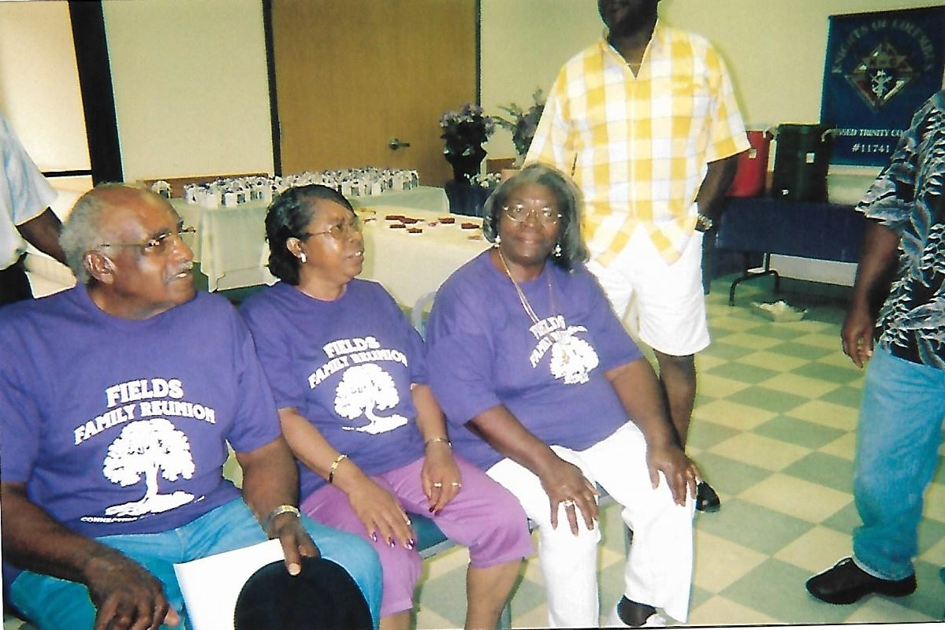
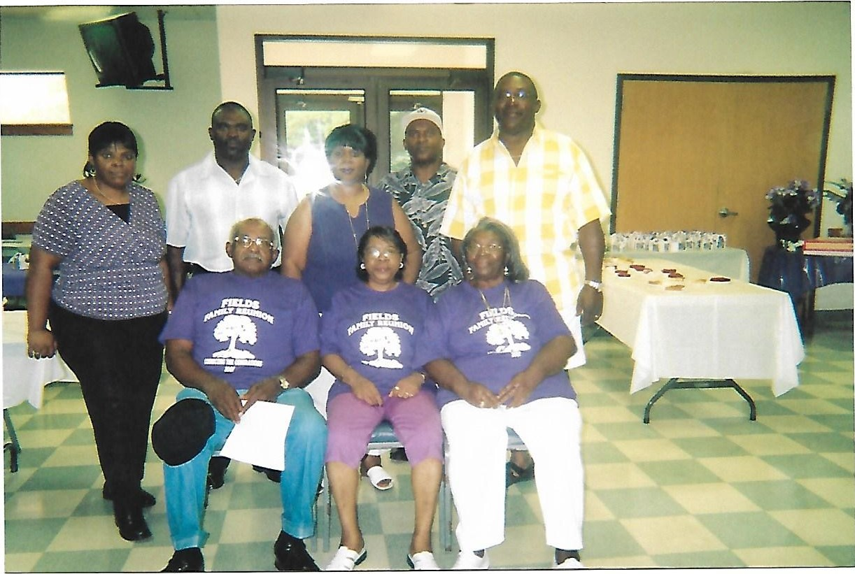
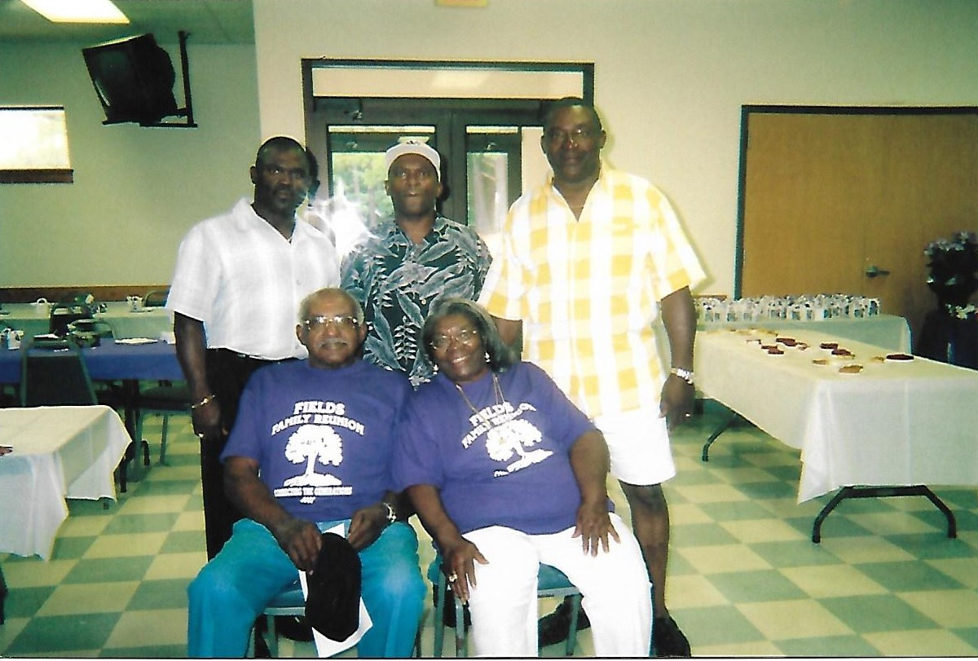
Fields Family Reunion 2007

Slide 15
Visiting Family After Church

Slide 16
Thanksgiving Family Photo

Slide 17
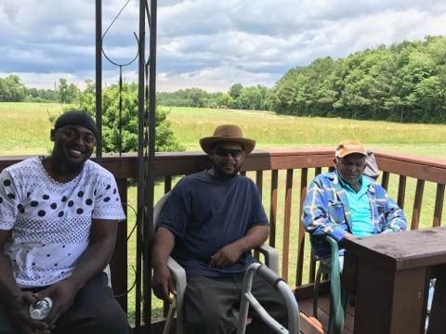
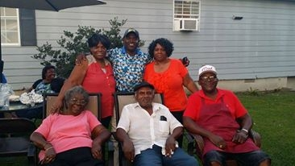
Family Times

Slide 18
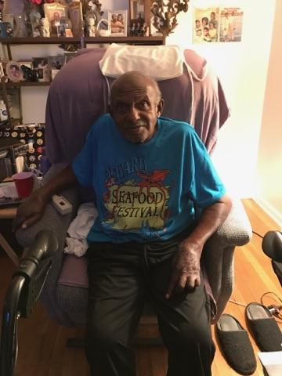
In My Comfort Zone

Slide 19
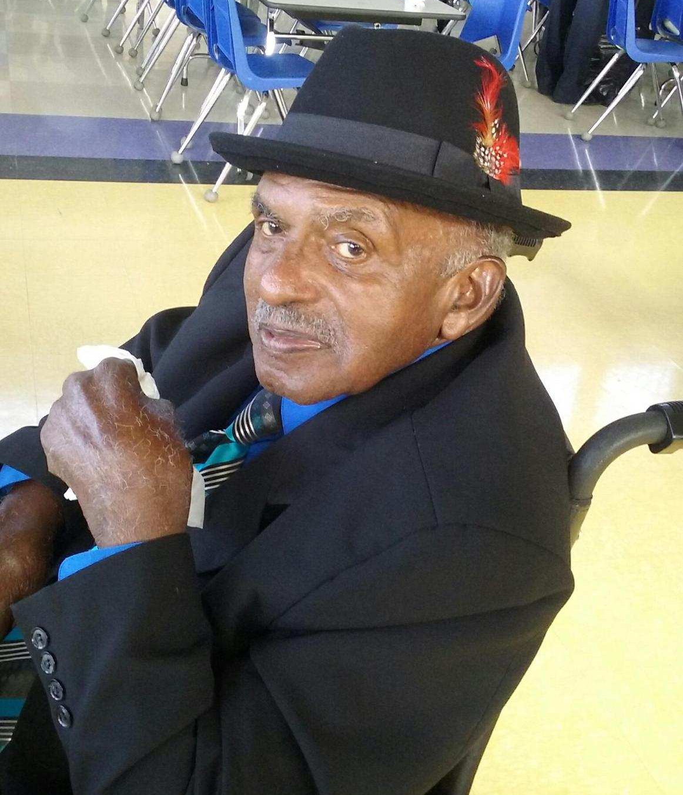
Today, We Celebrated Our Angel’s Arrival To Her Heavenly Home June 10, 2017

Slide 20
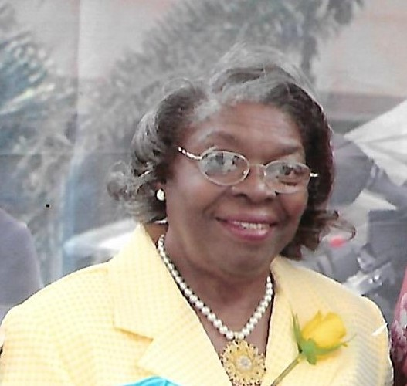
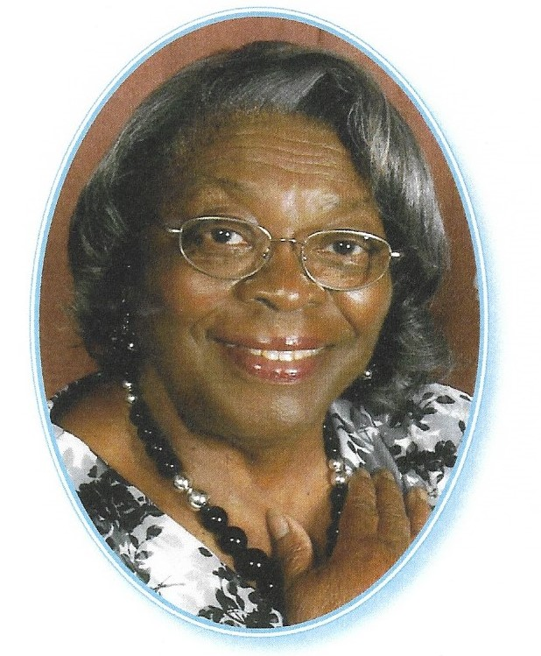
Rest In Peace My Love

Slide 21
Daddy and Daughter’s Birthday January 29, 2018

Slide 22
Thank You We Love You

