Slide 1

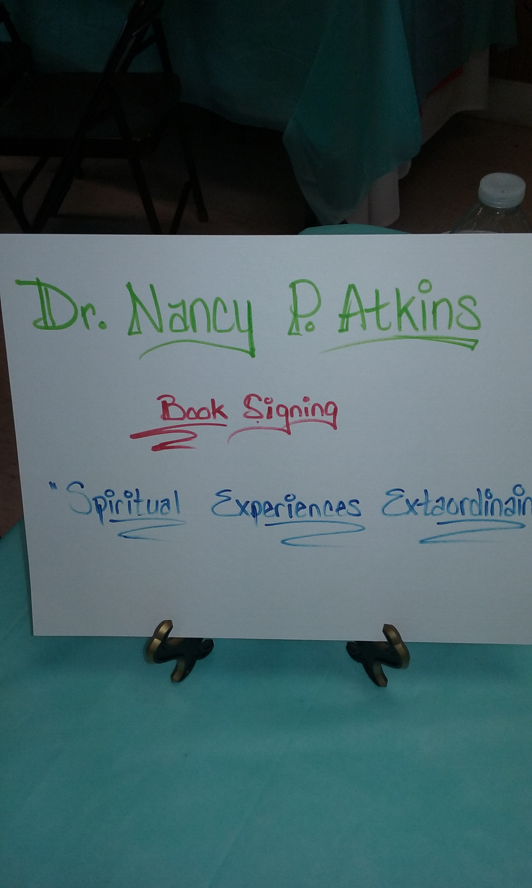
Women Of the Word (WOW)
Dr. Nancy P. Atkins
Book signing
March 24, 2018

Slide 2
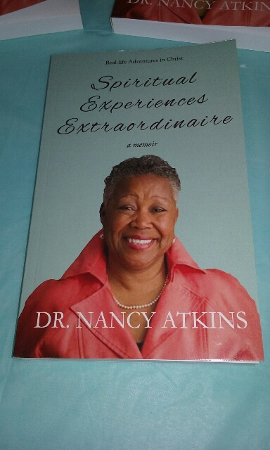
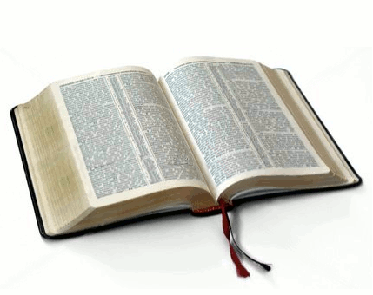
Book Cover

Slide 3
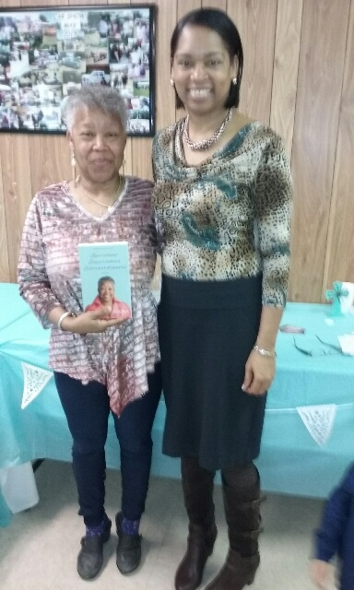
Dr. Atkins
and
Min. Jacqueline Alston

Slide 4

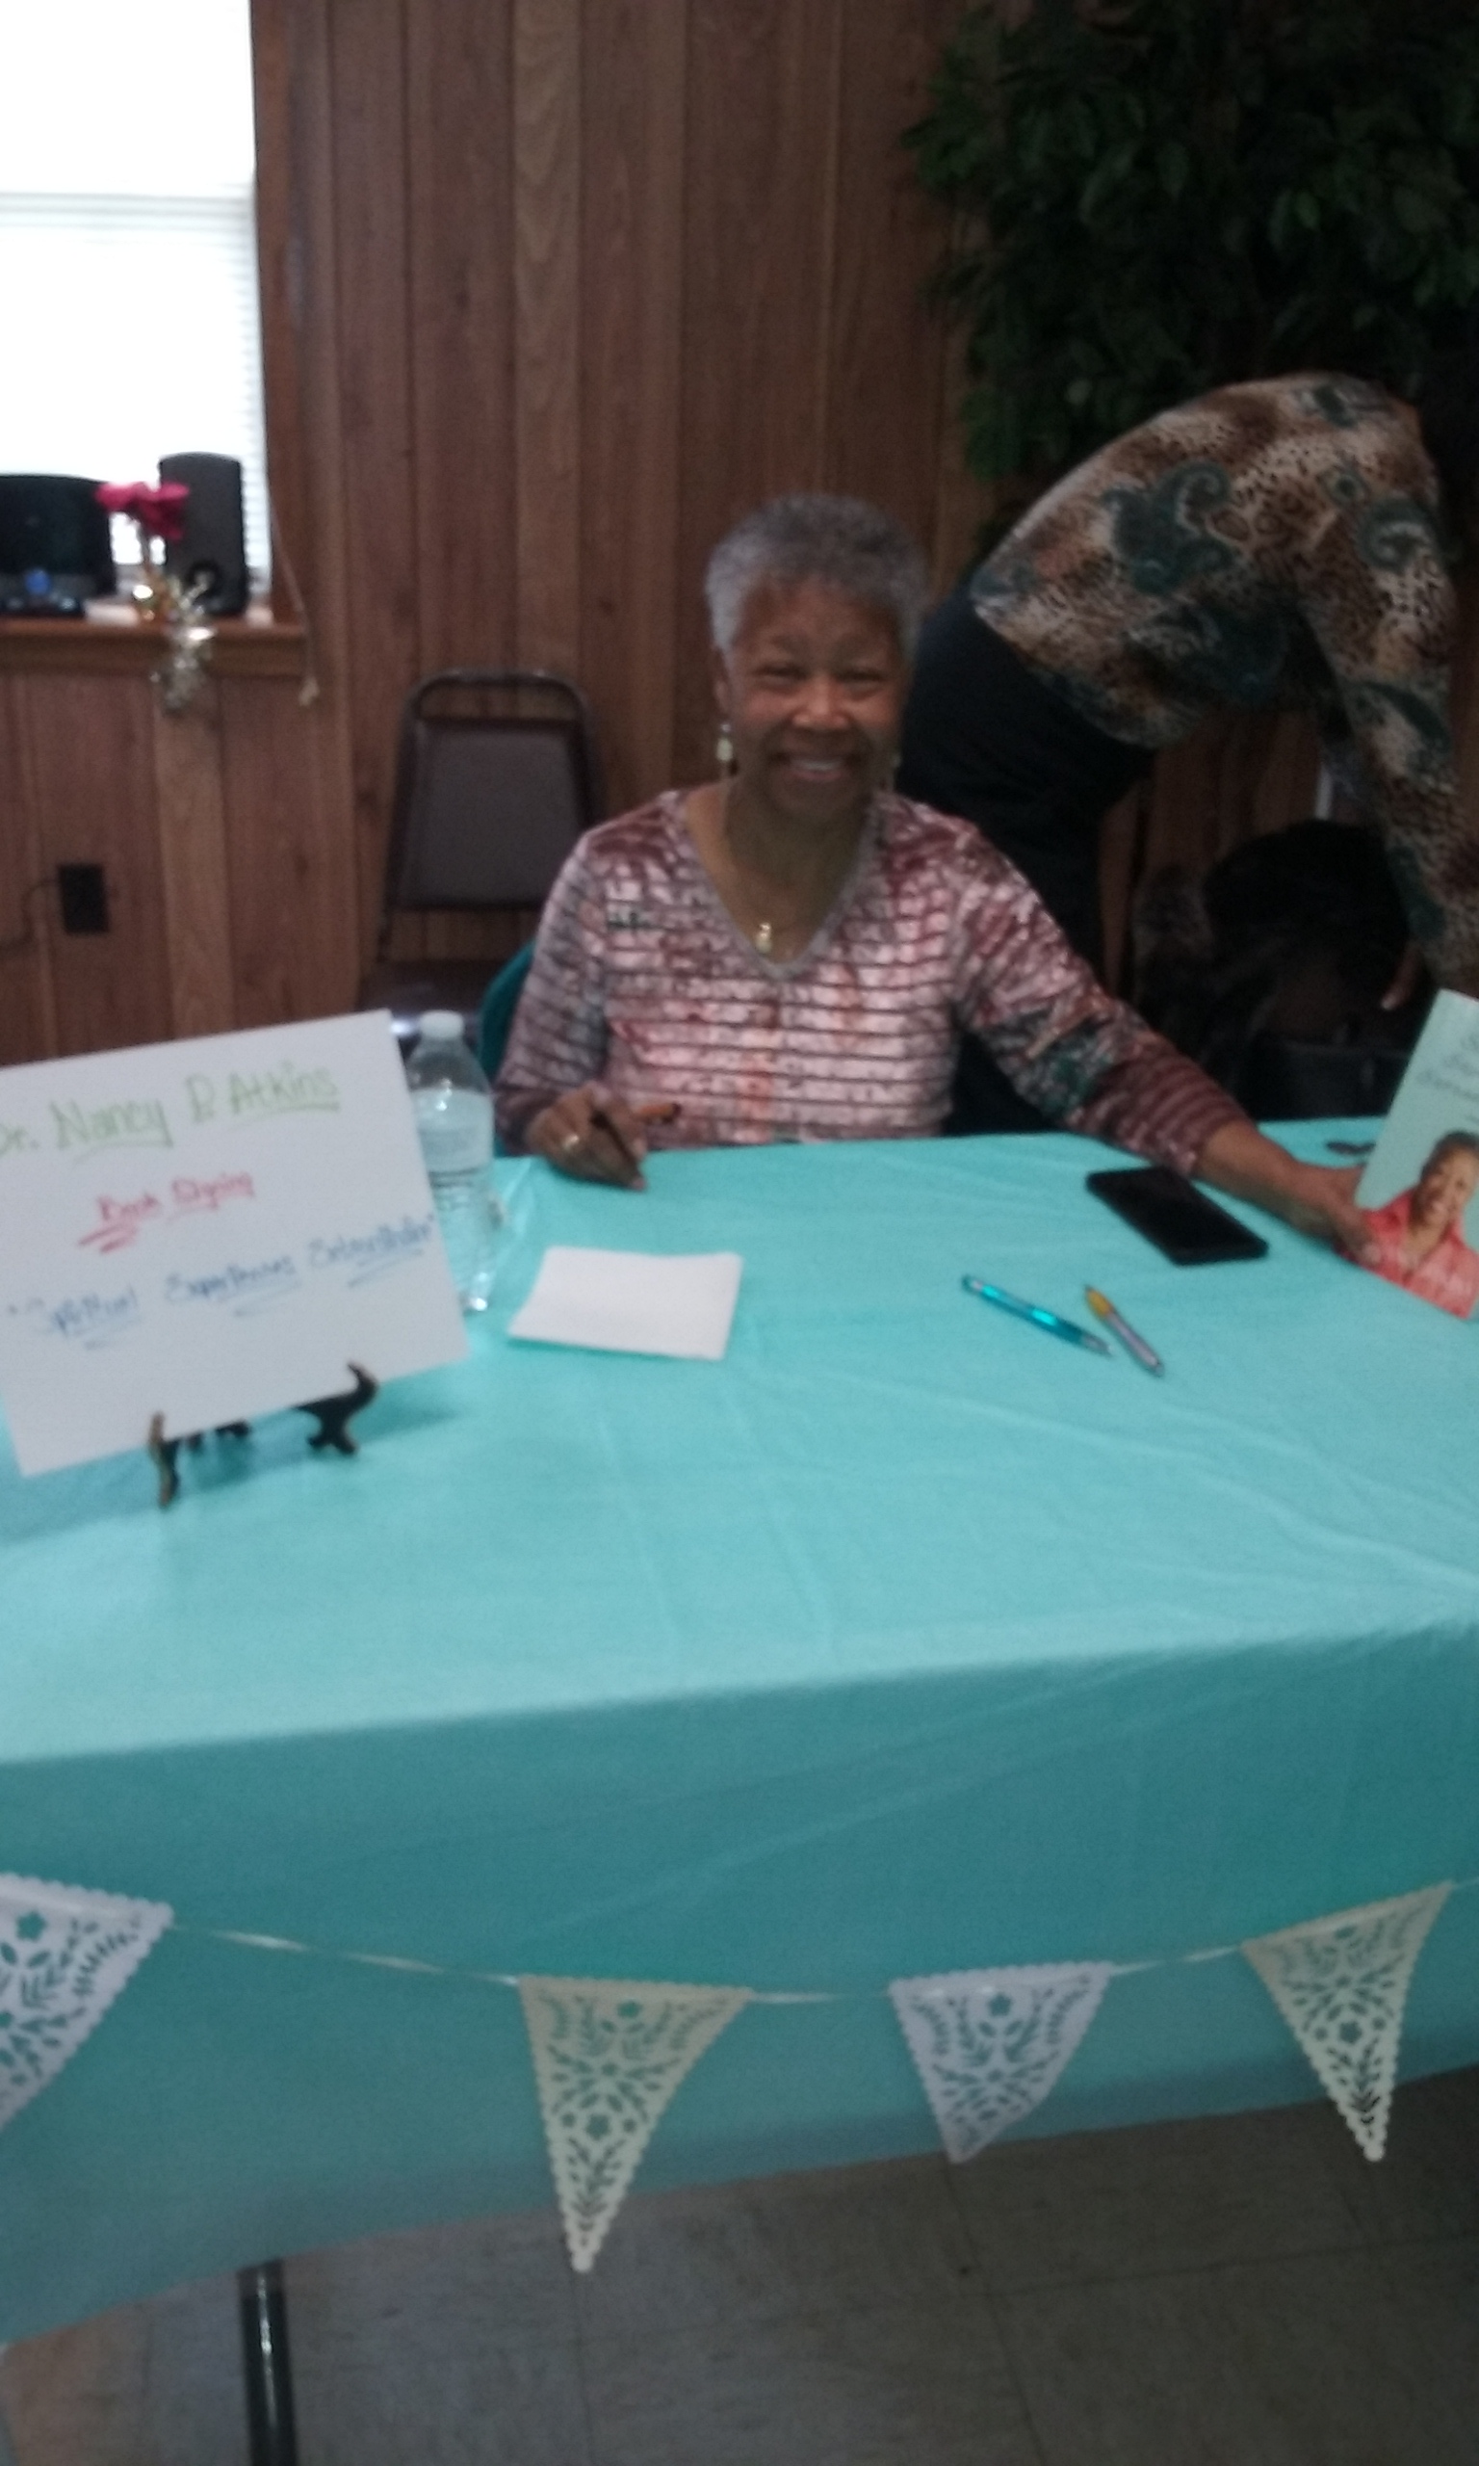
Book Signing Table

Slide 5
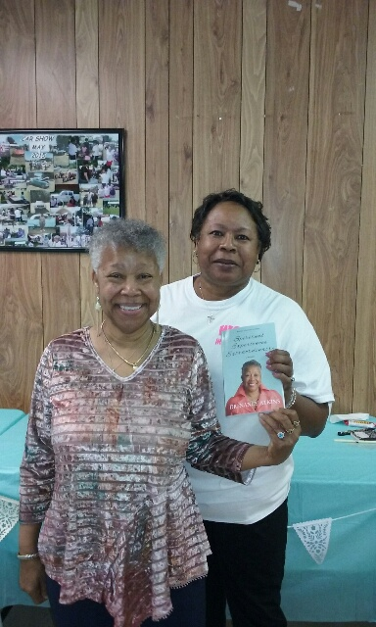
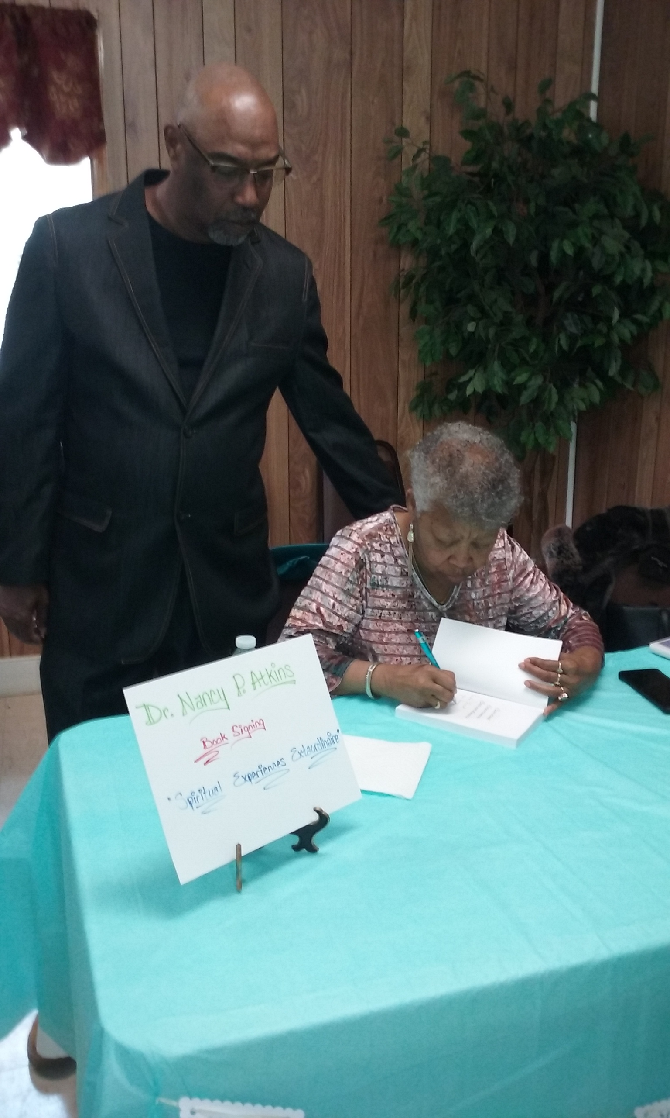
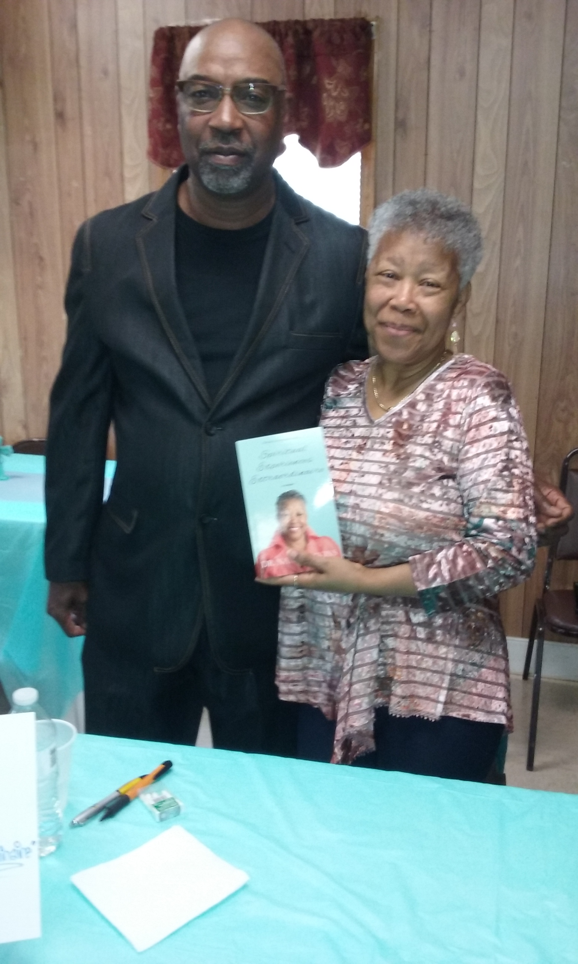
Pastor and First Lady Friend

Slide 6
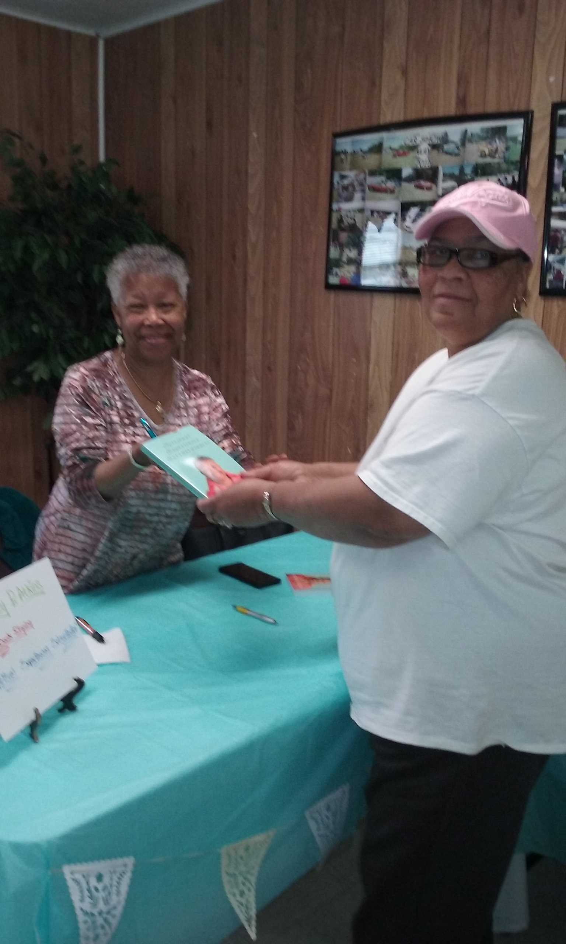
Deacon Jerline Lipscomb
First in line to purchase a book; a special prize was given. Congratulations

Slide 7
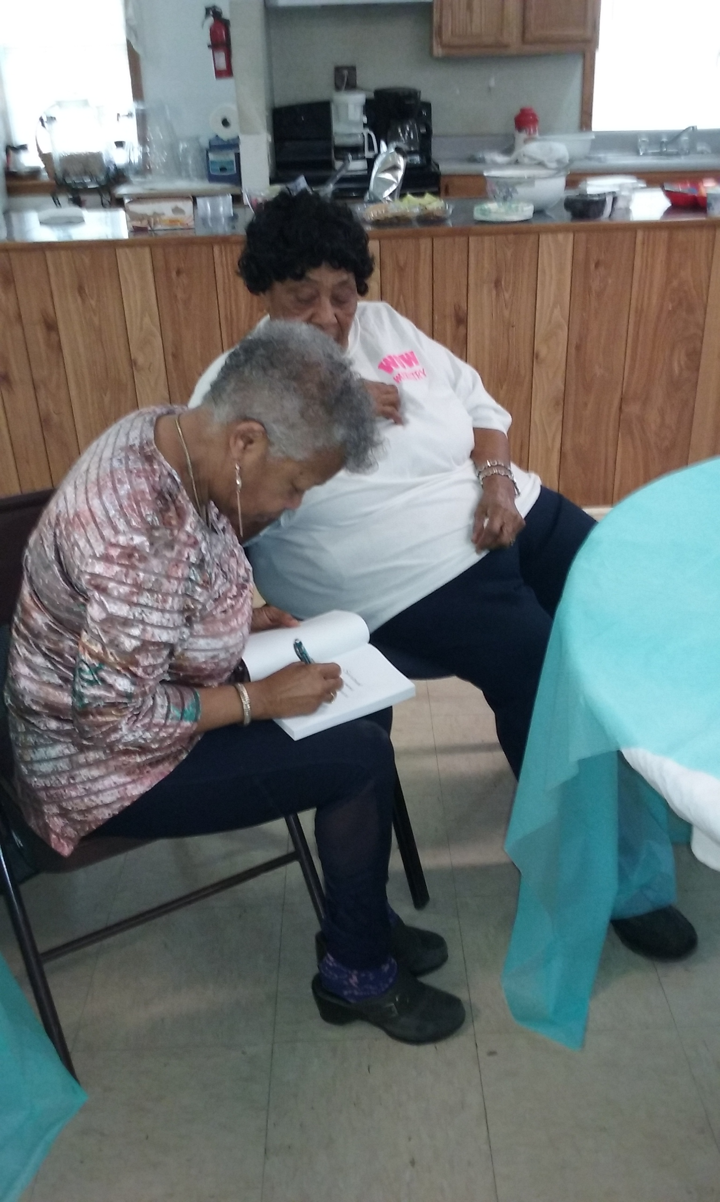
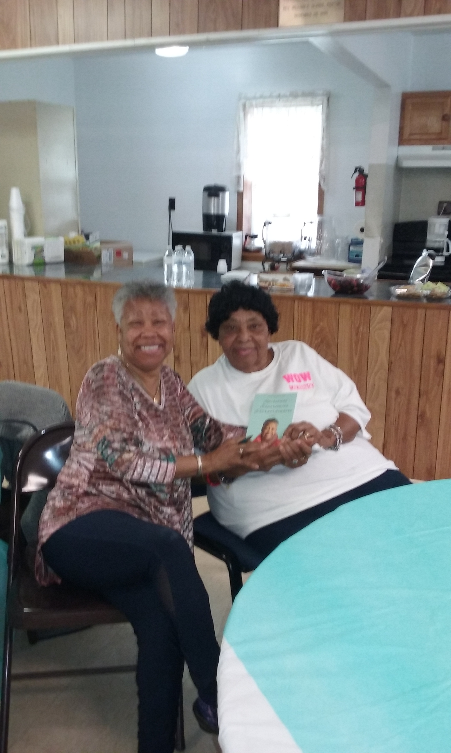
Church Mother Deaconess Perline Seward
Looking on as her book gets signed before it is presented

Slide 8
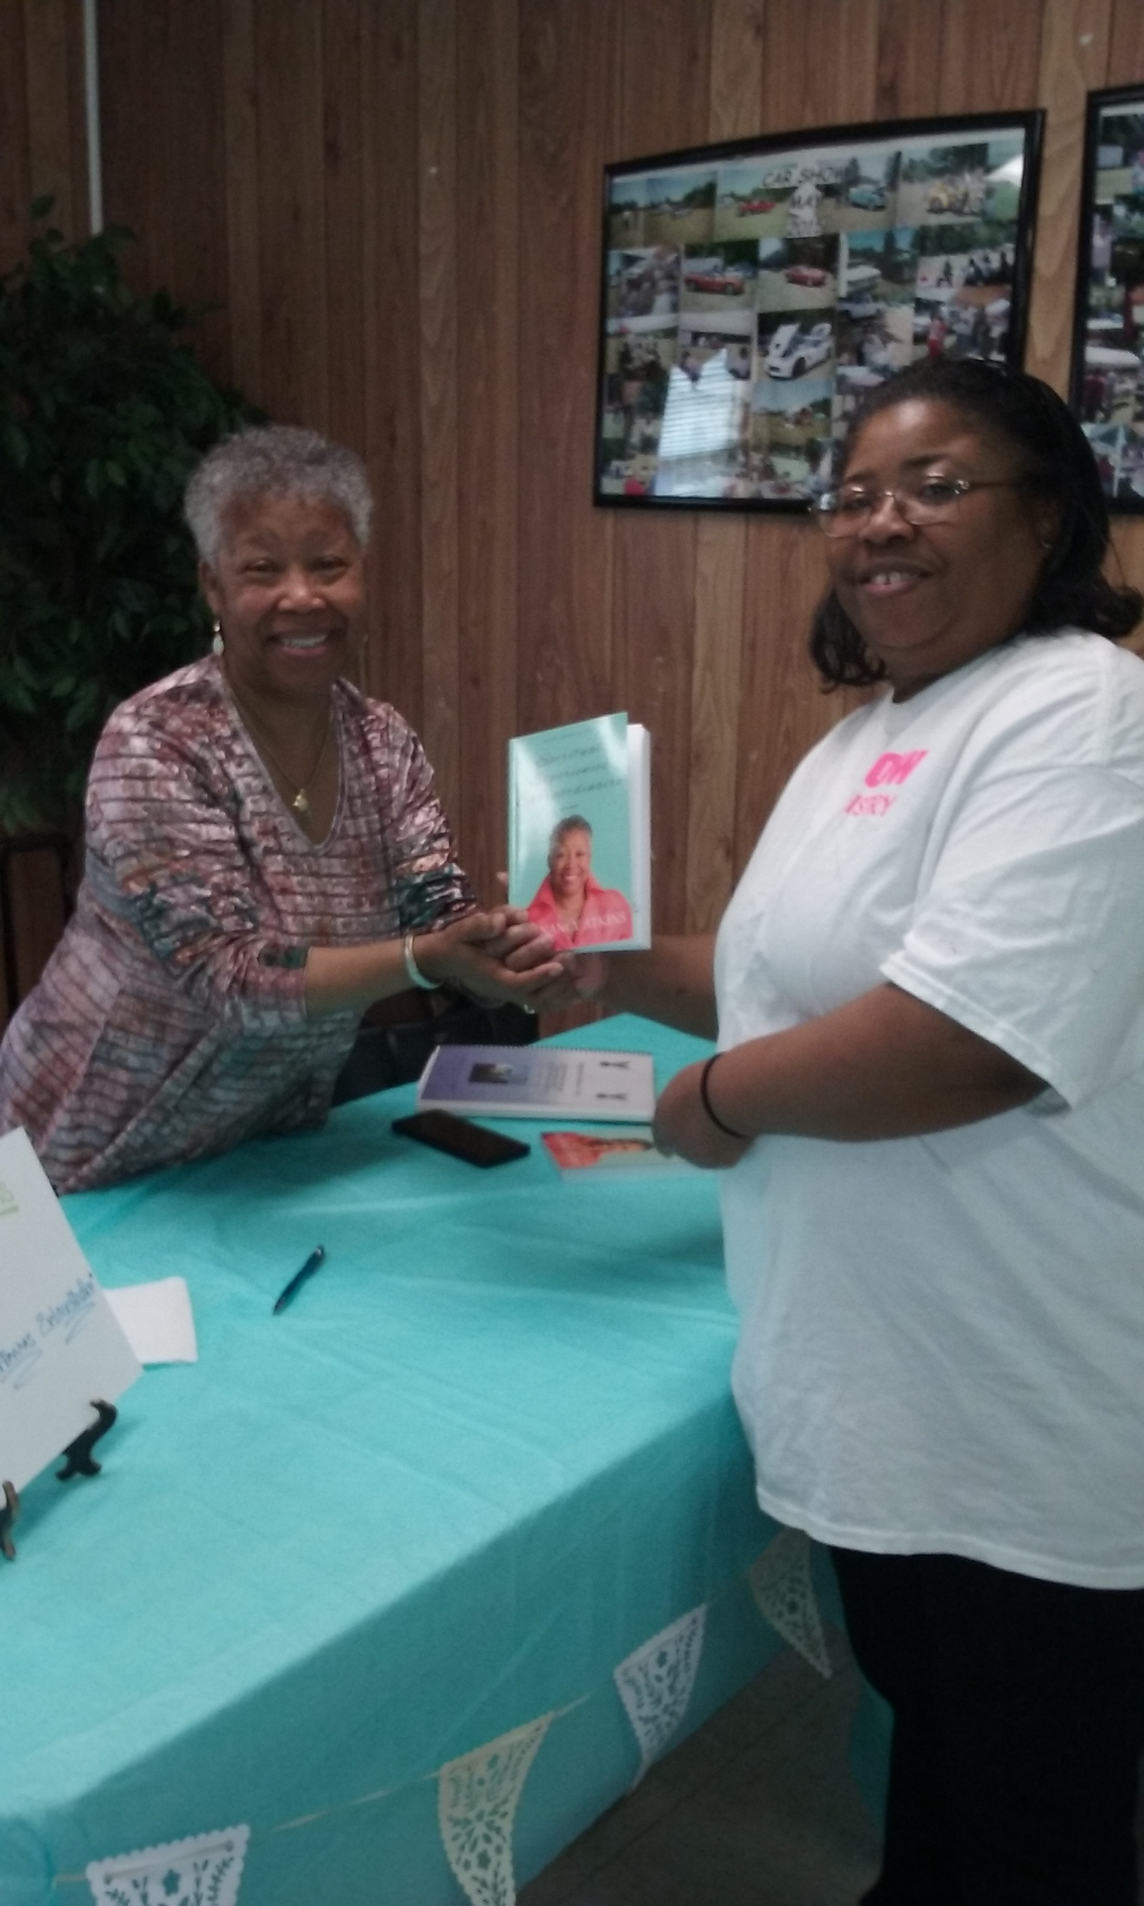
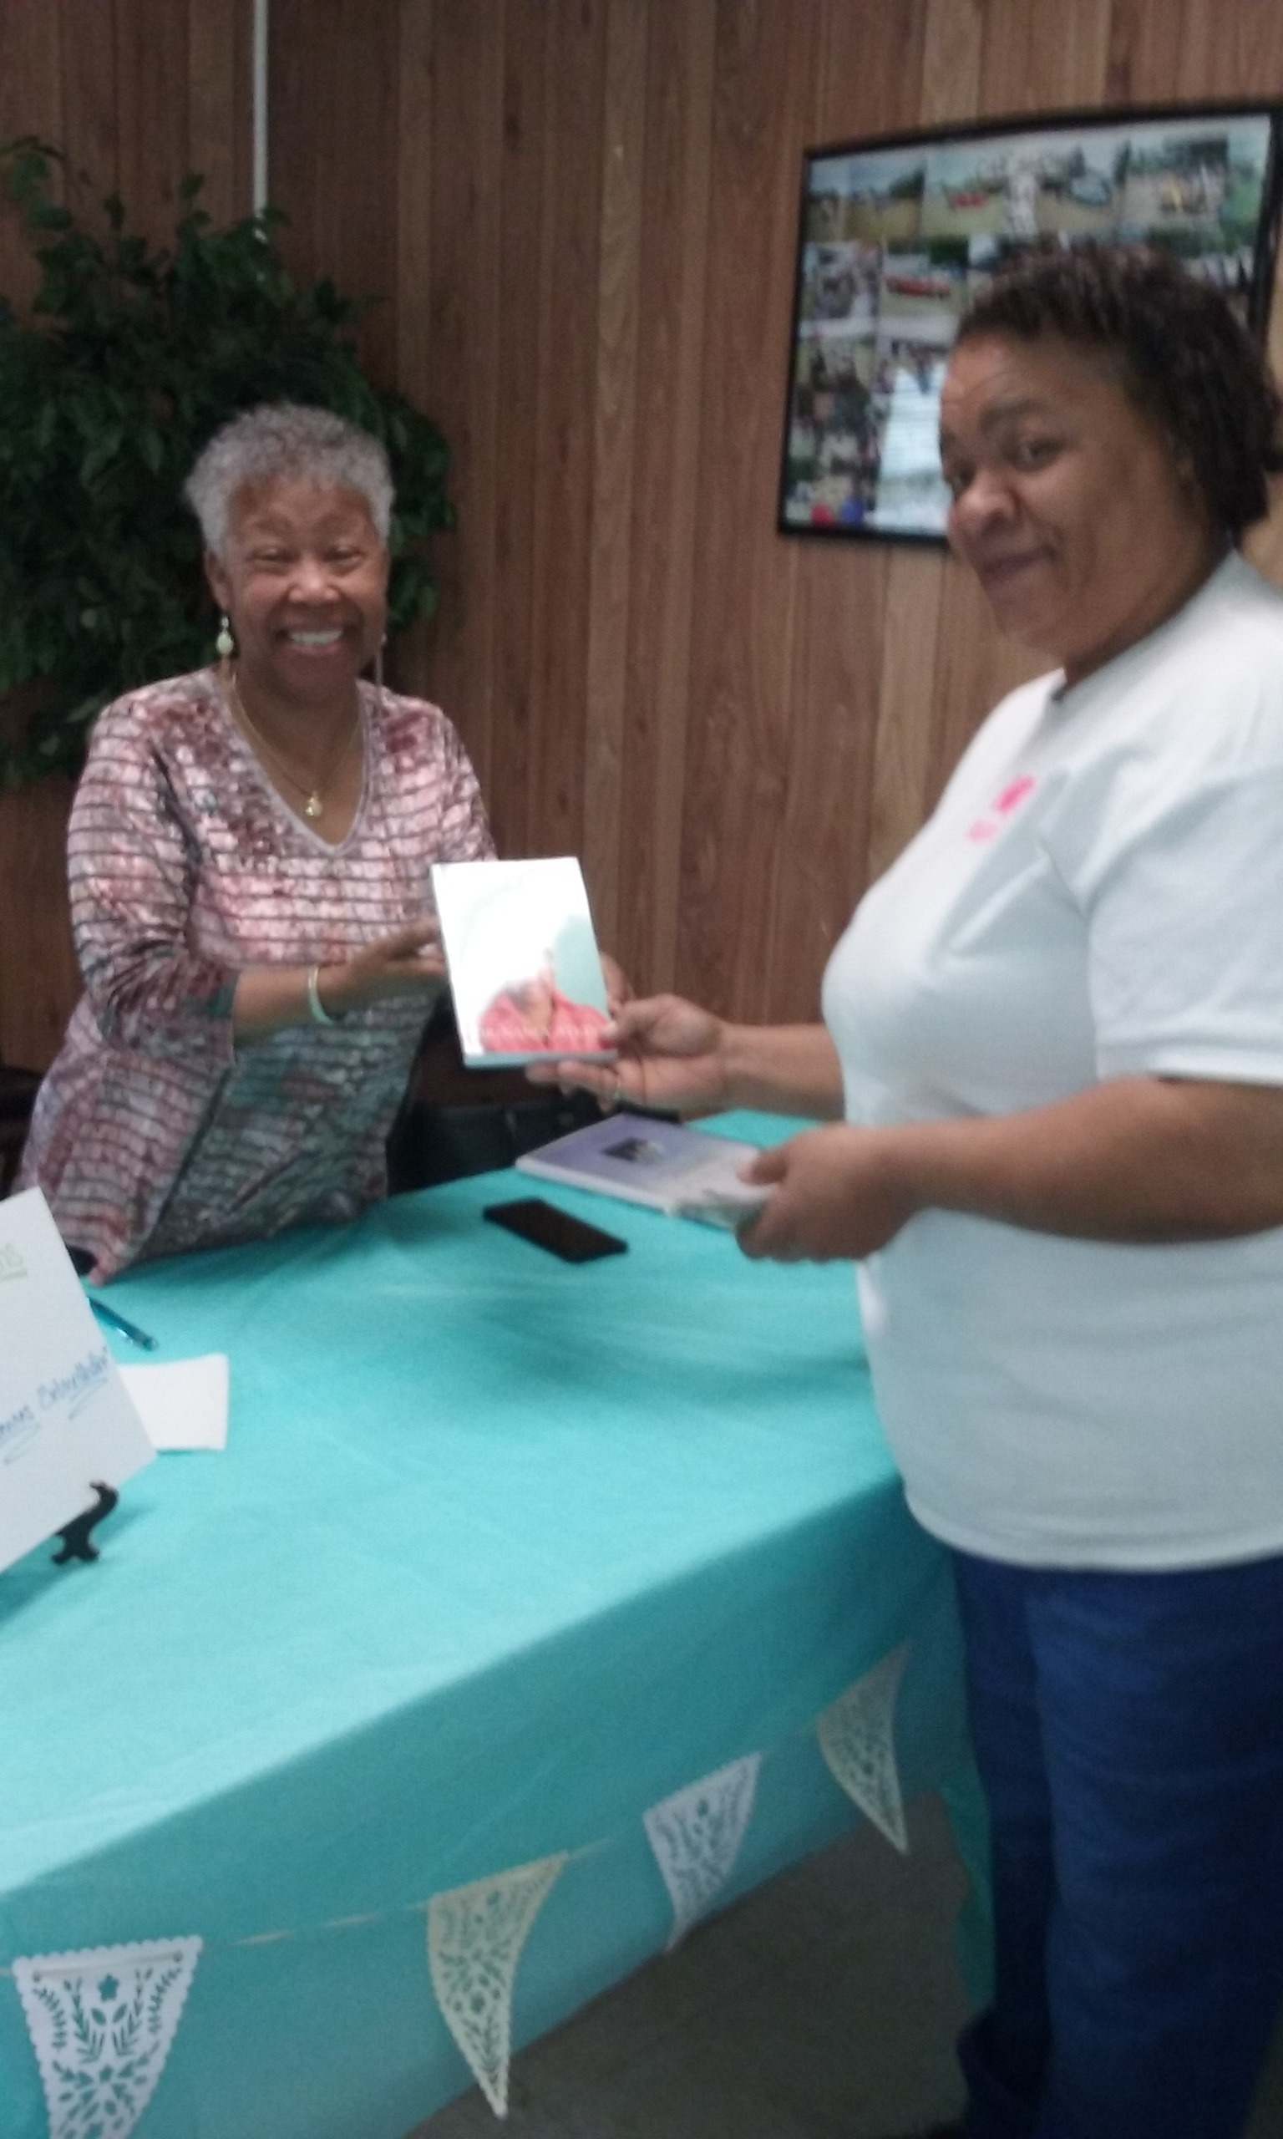
Deaconess Corine Phillips
Deaconess Shirley Phillips

Slide 9
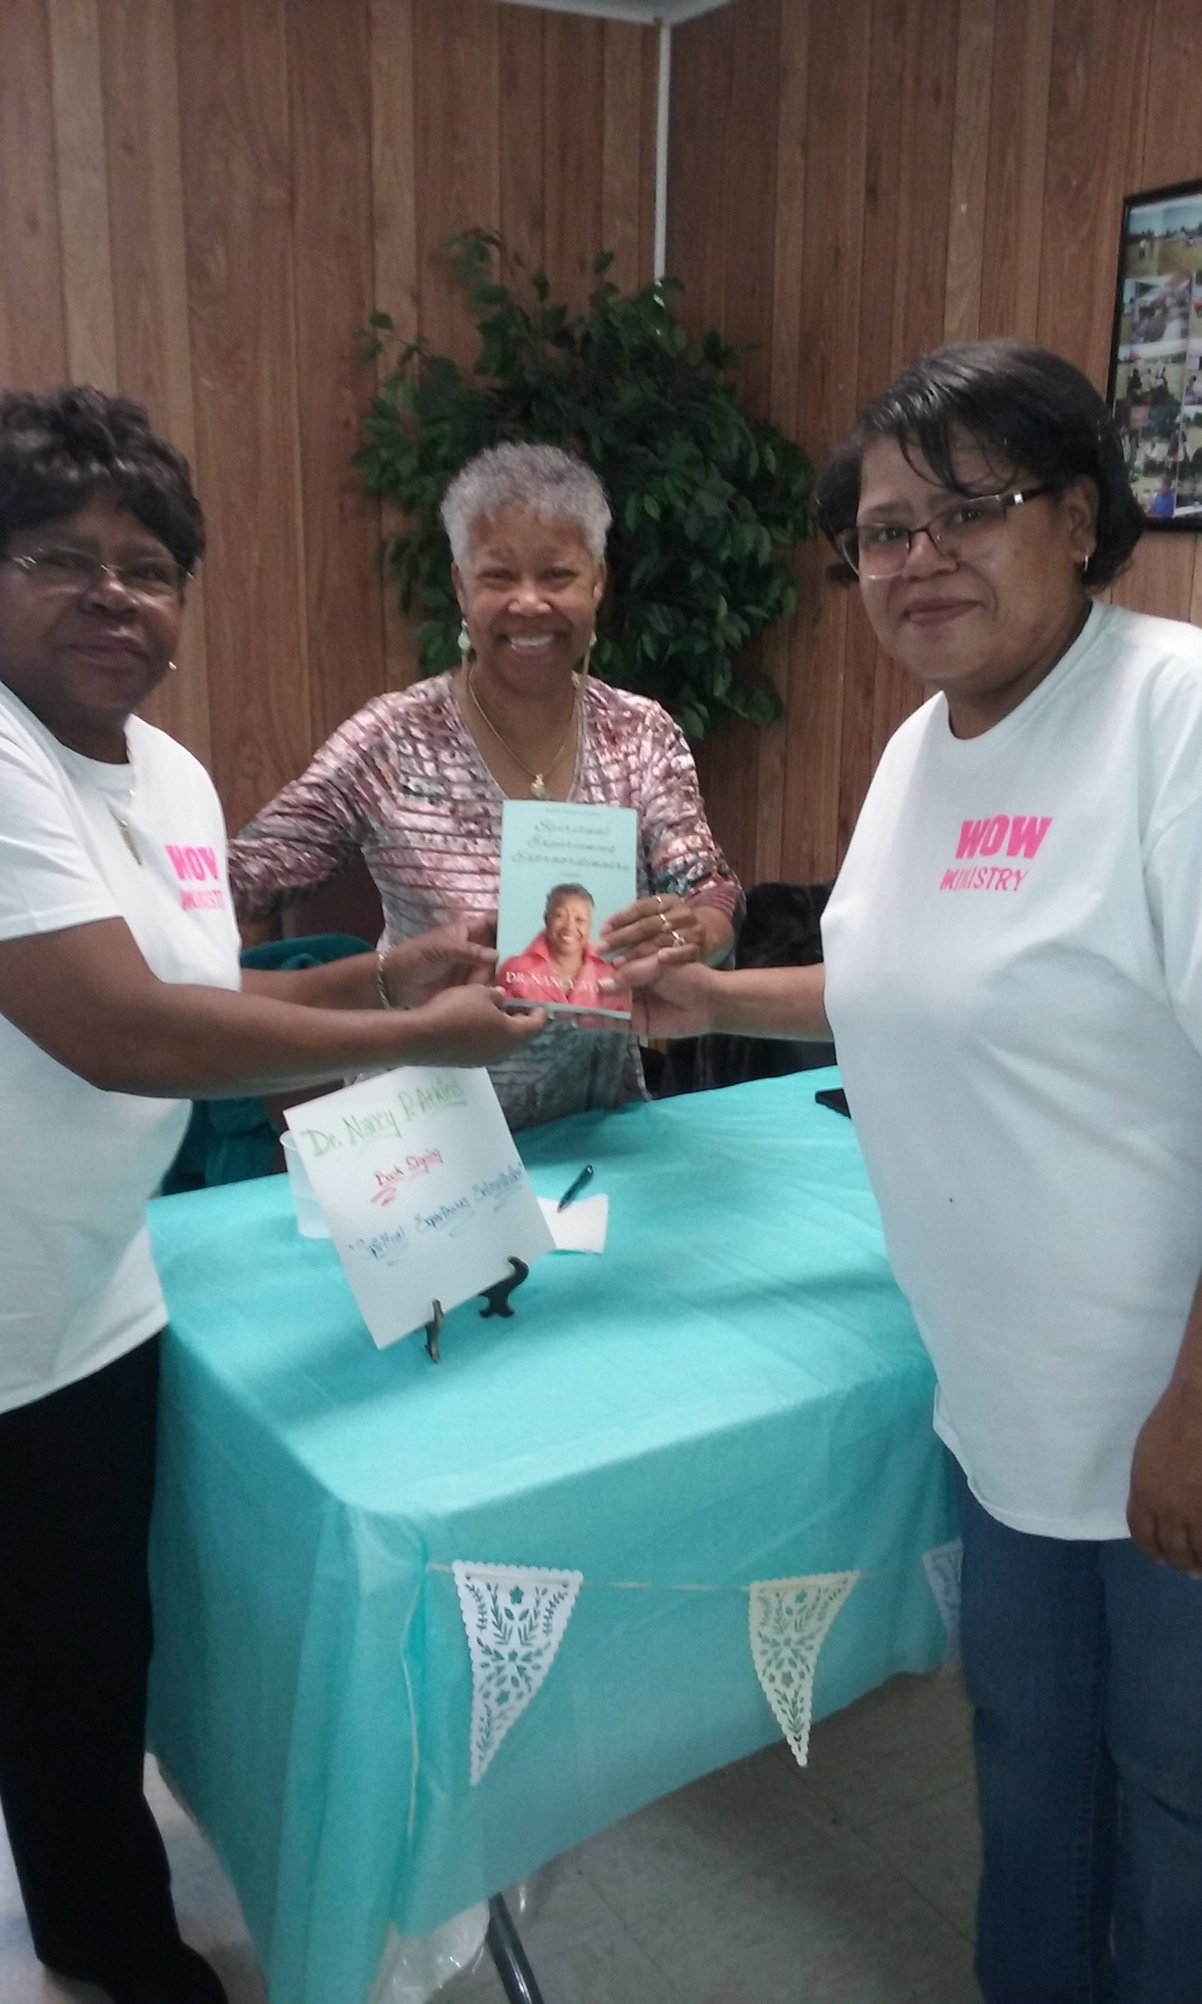
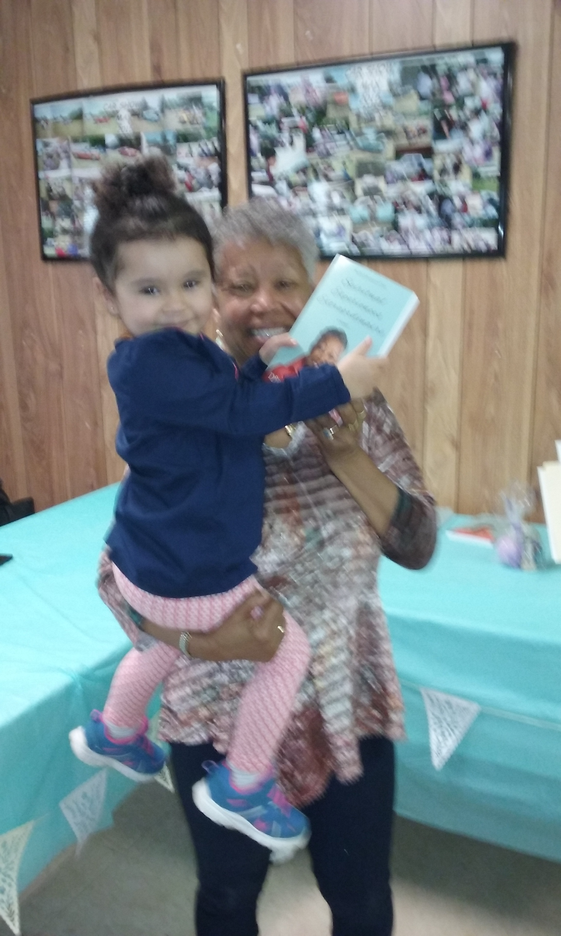
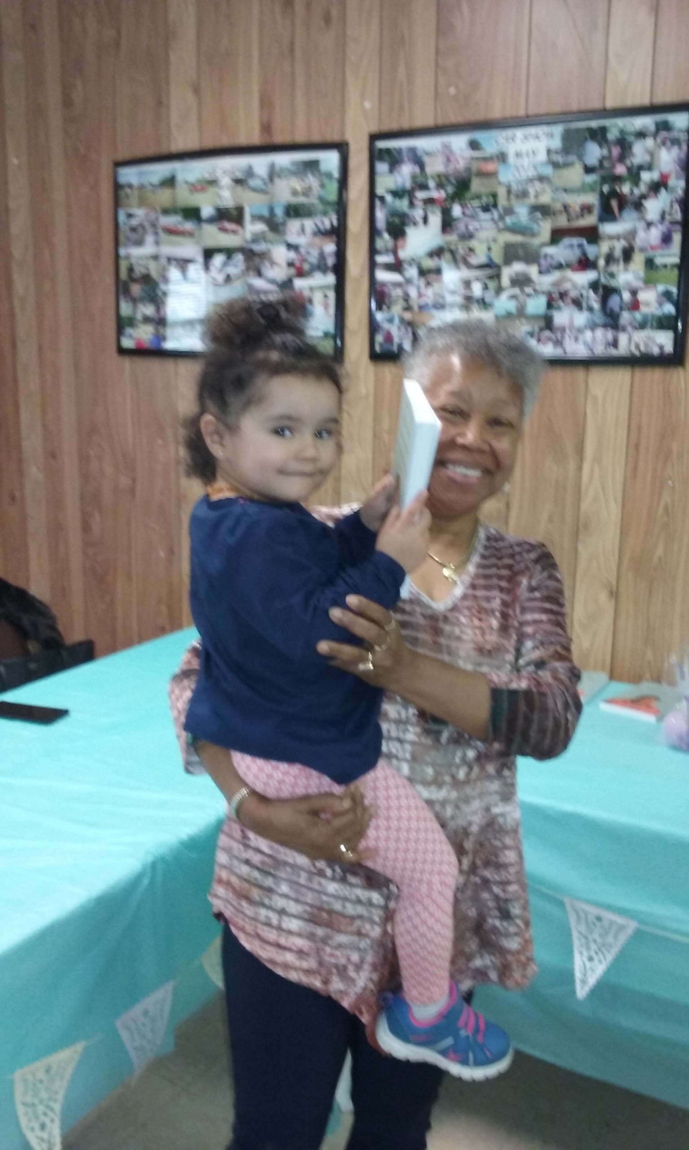
Dr. Atkins Holding Cadence Renee Seward Margaret’s granddaughter
Deaconess Margaret Seward and daughter Monica Seward

Slide 10
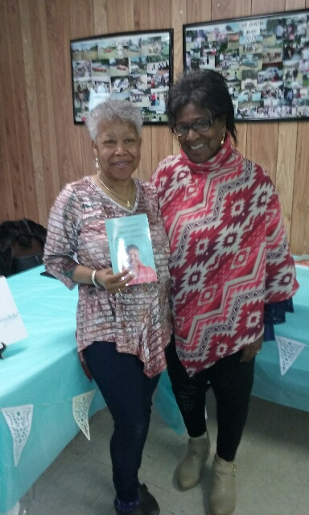
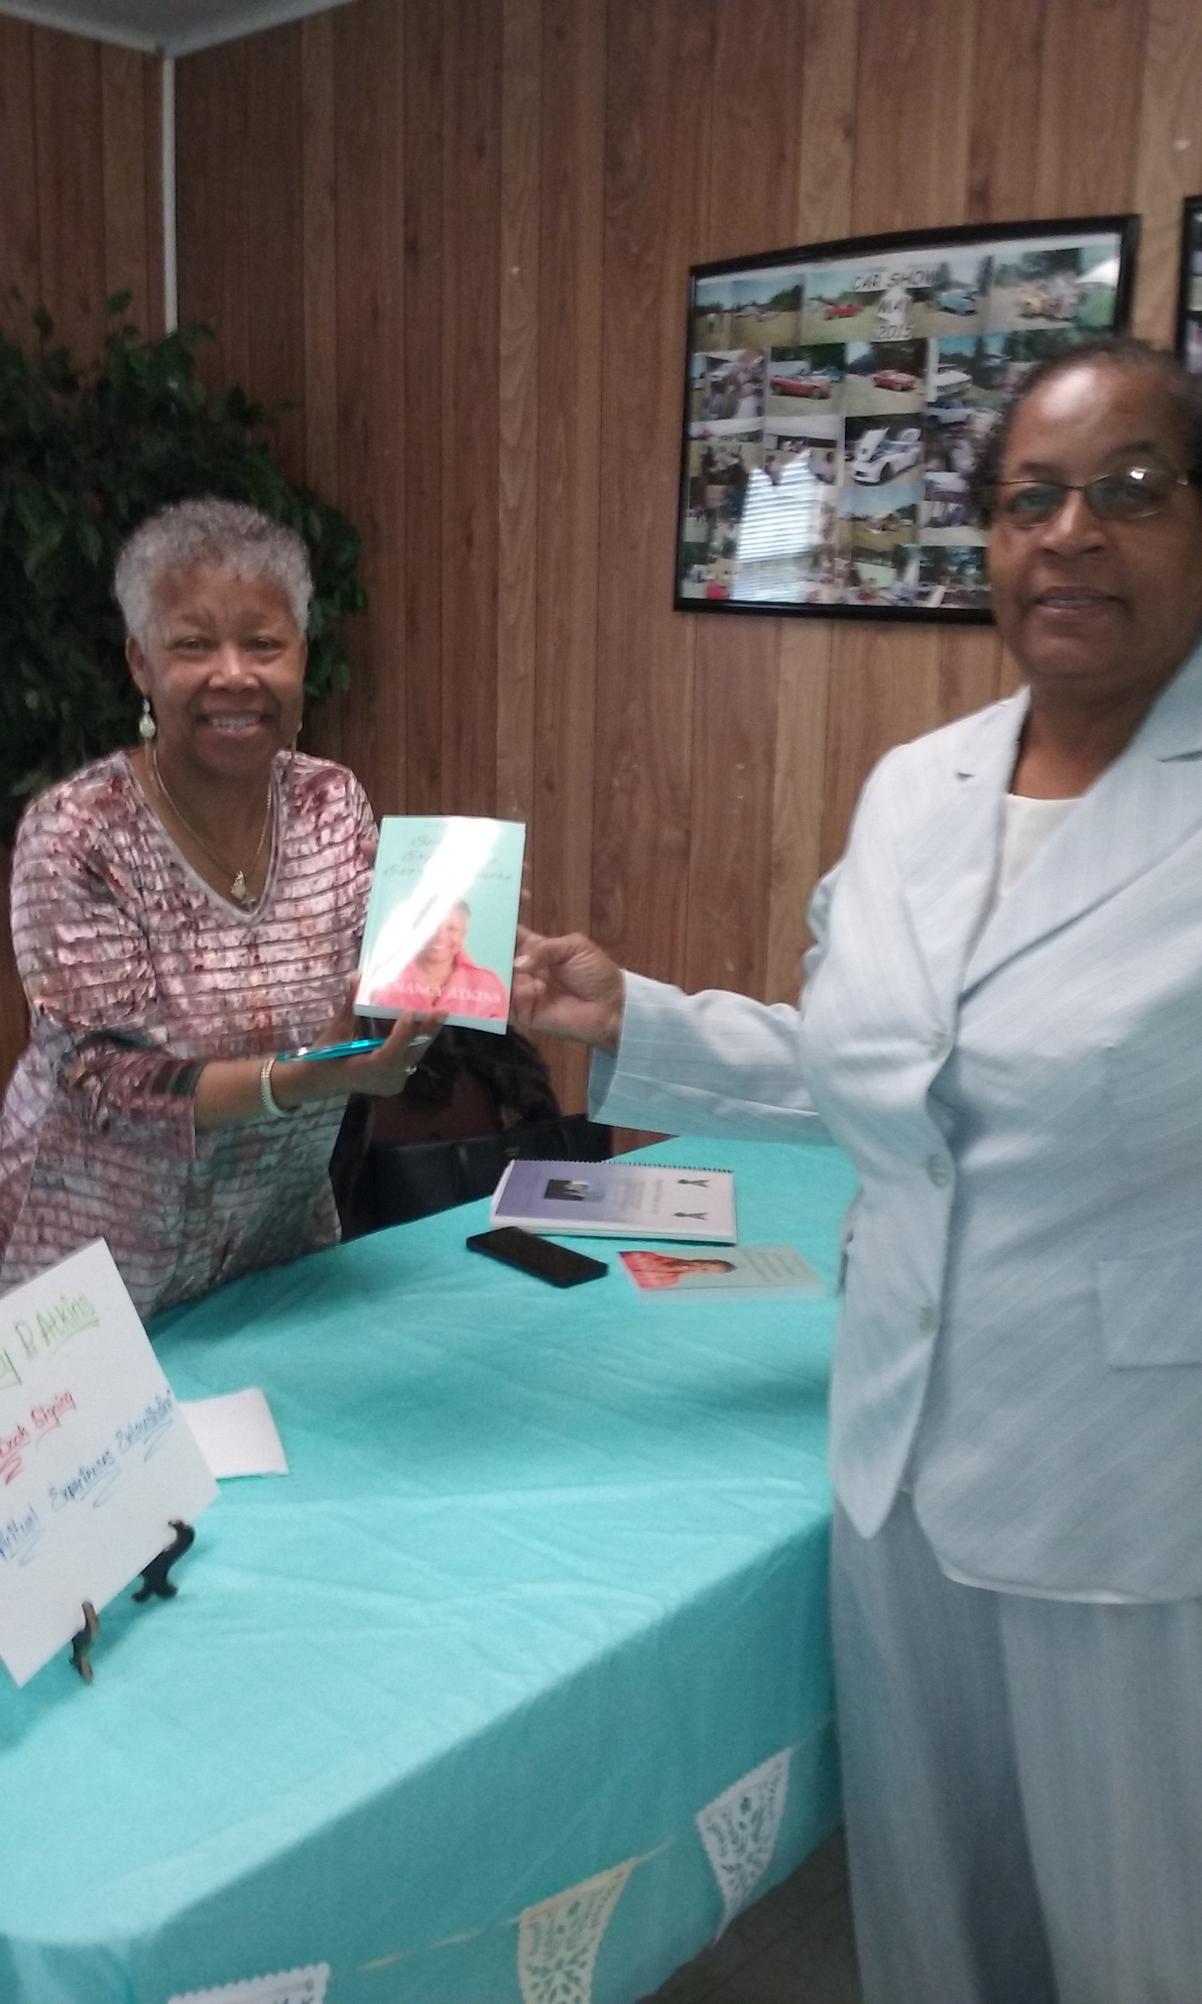
Special Guest
Deacon Gloria Mallory Mason Grove Baptist Church, Freeman, VA

Slide 11
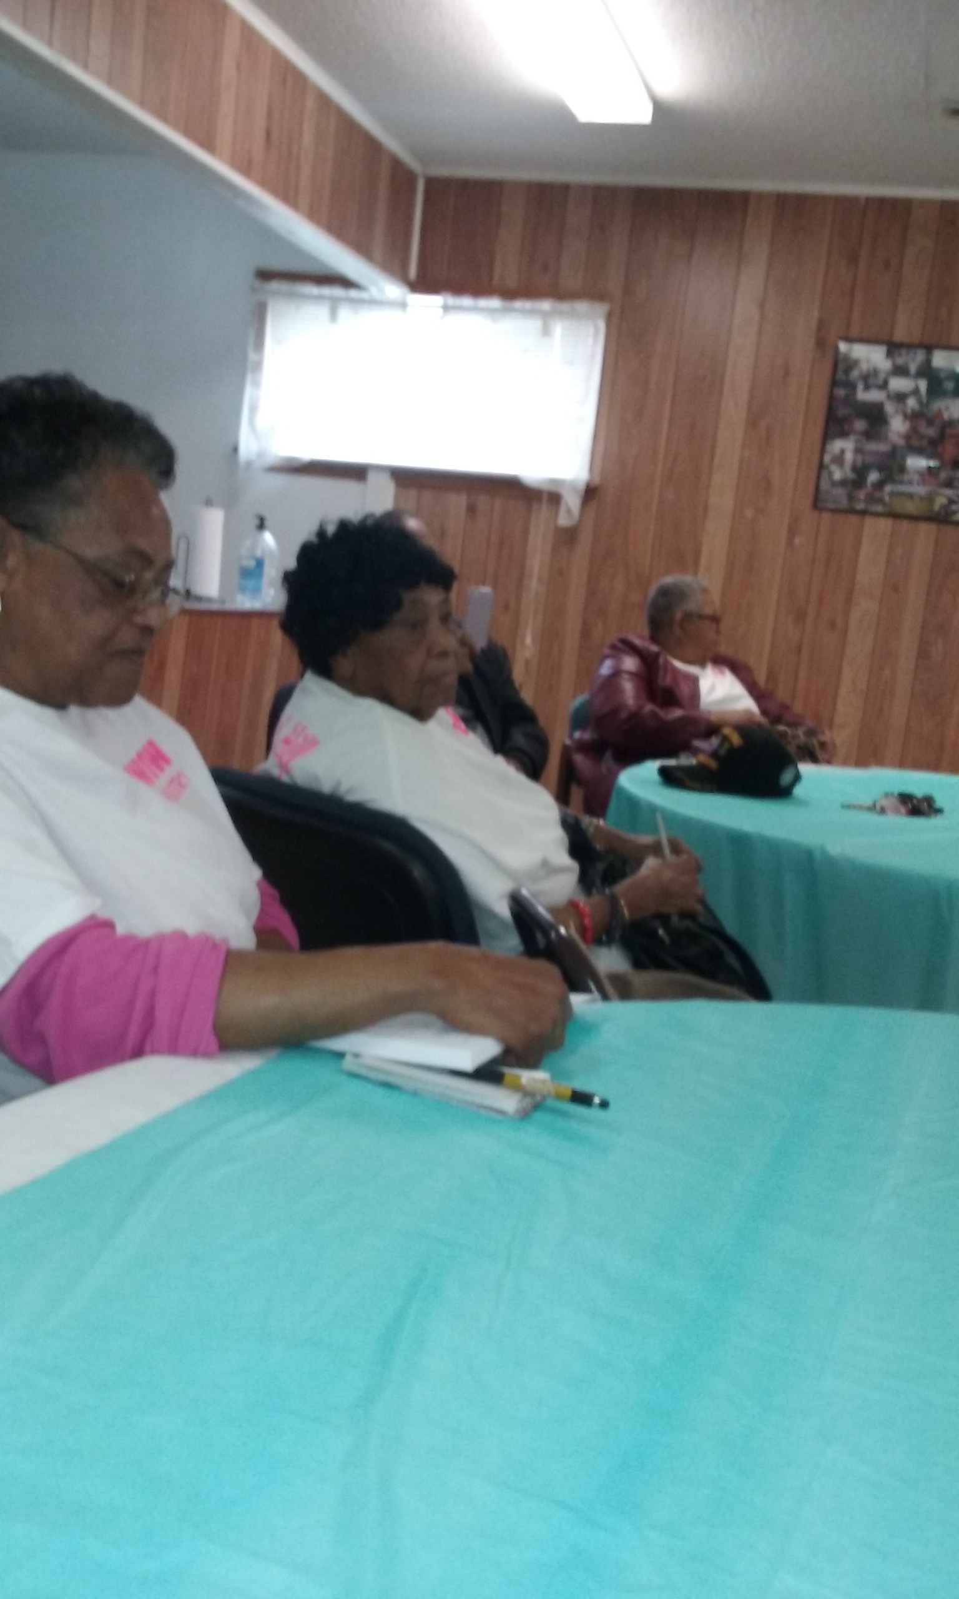
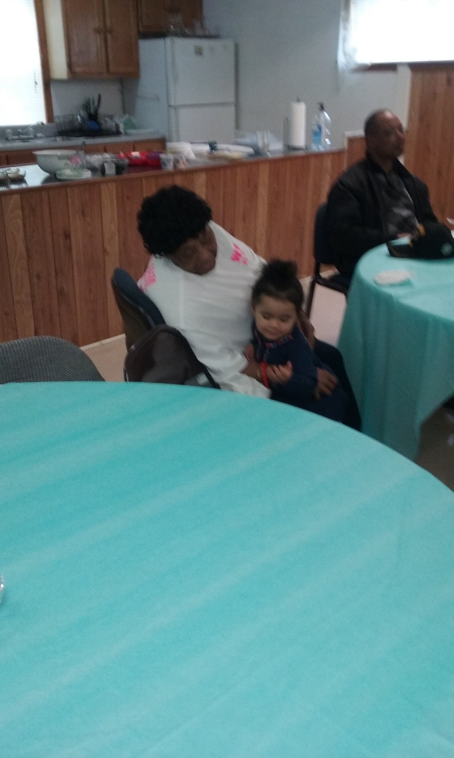

Mother and Daughters
Deaconess Maude Edmonds Bell (left)
Sister Gloria Marshall (right)
Church Mother, Deaconess Perline Seward (center)
Church Mother, Deaconess Perline Seward with great granddaughter, Cadence

Slide 12
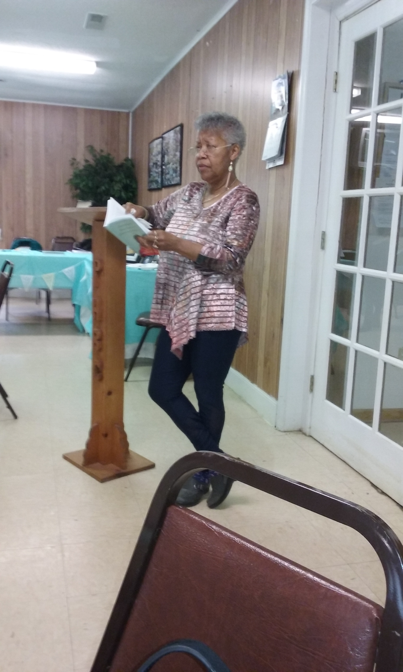
Dr. Atkins reading excerpts from her book to the audience.

